Slide 1
“Hi, How Are You?”Day: An Analysis and Strategic Plan
CITY OF AUSTIN ECONOMIC DEVELOPMENT DEPARTMENT
By: Simone Wilson, music & Entertainment Division

Slide 2
Austin’s
Prosperity Engine
The City of Austin’s Economic Development Department
(EDD) develops and leads innovative programs
that increase the prosperity of all Austinites, our
businesses, and our diverse communities.

Slide 3
SWOT
Strengths
Weaknesses
Opportunities
Threats
Source: Greater Austin Chamber of Commerce. As of March 2014. Counts do not include agreements for exclusively residential projects.

Slide 4
STRENGTHS
Cohesive group of stakeholders
Administrative support of the Economic Development Department
Support of the Mayor’s Office
Appropriate line up

Slide 5
WEAKNESSES
Requires a great deal of ahead planning and preparation
Lack of stated outcomes
Rushed marketing resulting in siloes marketing efforts

Slide 6
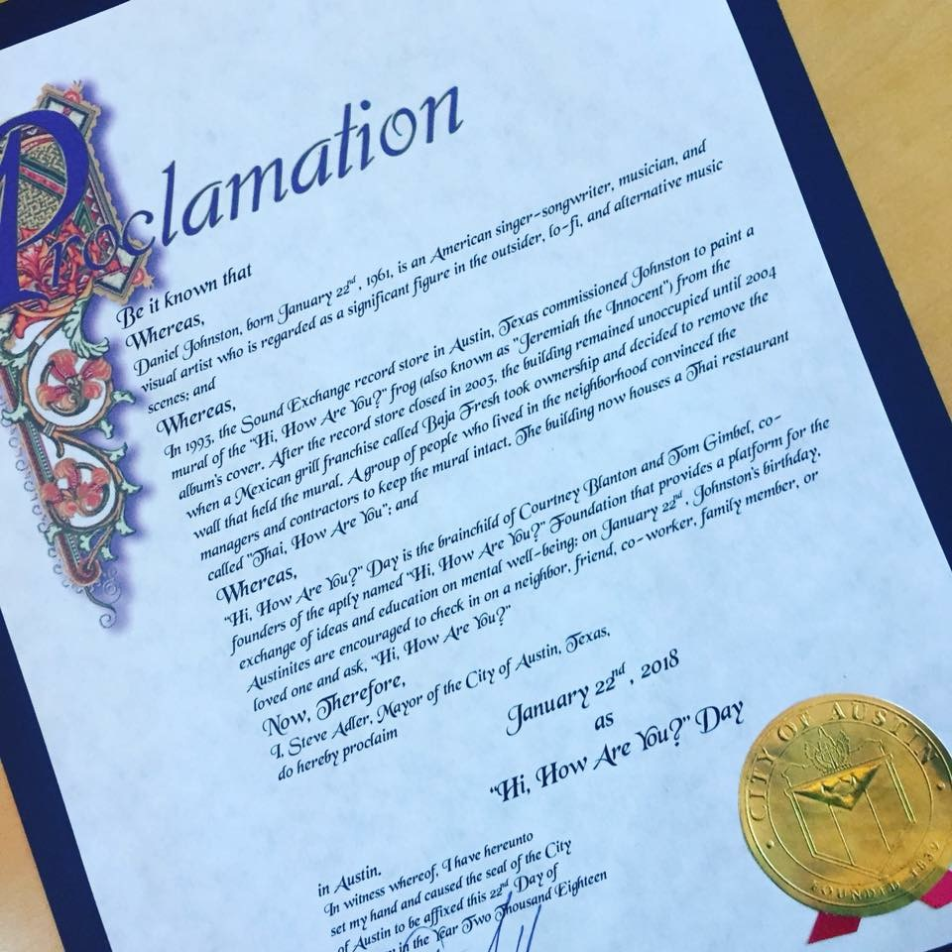
OPPORTUNITIES
Expand audience and attendance
Year round education/programming
Advanced planning and messaging
Increased awareness of mental health services provided by local organization

Slide 7
THREATS
Competing event beneficiaries
Redundant efforts by partner organizations
Does an event like this create new conversation around mental wellness

Slide 8
Strategic Plan Main Points
Expand audience and community engagement
Strengthen key partnerships
Further enhance and expand reputation of event

Slide 9
Conclusion
The SWOT analysis was a useful exercise that is intended to help our Division began to focus on strategic planning.
In implementing a public program, we must align ourselves with events, media and partners that carry out our mission.
Source: Greater Austin Chamber of Commerce. As of March 2014. Counts do not include agreements for exclusively residential projects.

Slide 10
QUESTIONS?

Slide 11
Thank You!

