Slide 1
Organizational Leadership
National Forum for Black Public Administrators
National Conference – Cleveland, Ohio
Jim Robinson
Executive Director, CEPL
April 20, 2018
Notes:
Notes/Ideas
Key Takeaways
Ideas for Application

Slide 2
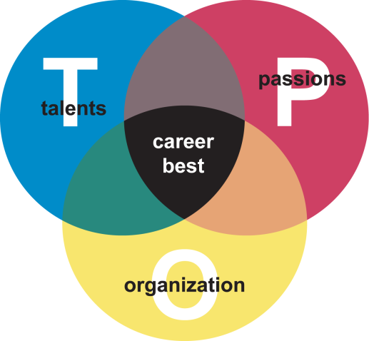
The TOP® Model
Notes:
Notes/Ideas
Key Takeaways
Ideas for Application

Slide 3
Theory of the Case
Boss’s Leadership Behaviors
Climate
Drive
Arouses
Motivation
Improved Performance
Leads to
Notes:
Notes/Ideas
Key Takeaways
Ideas for Application

Slide 4
Elements of Motivation 3.0: Psychological Empowerment Intrinsic Motivation
Autonomy: Acting with choice
Mastery: Getting better at doing something that matters.
Purpose: Being connected to a larger cause
Humans are designed to be active and engaged!
Notes:
Notes/Ideas
Key Takeaways
Ideas for Application

Slide 5
Psychological Empowerment
Meaningfulness
Self-Determination
Psychological Empowerment
Competence
Challenge
Impact
Notes:
Notes/Ideas
Key Takeaways
Ideas for Application

Slide 6
Leadership Practices which Most Impact Climate
 Model the Way
Demonstrates
Personal Commitment
to Achieving Goals
Commitment
Standards
Structure
Recognition
 Challenge the Process
Commitment
Standards
Support
Responsibility
Recognition
Encourage
Innovation and
Calculated Risk Taking
Leadership and Organizational Climate by Robert Stringer & The Leadership Challenge by Kouzes and Posner
Notes:
Notes/Ideas
Key Takeaways
Ideas for Application

Slide 7
Leadership Practices which Most Impact Climate
 Enabling Others to Act
Clarifies
Who Is Responsible
for What
Structure
Responsibility
Support
Commitment
 Inspire A Shared Vision
Sets
Challenging
Goals and Aspirations
Standards
Commitment
Responsibility
Leadership and Organizational Climate by Robert Stringer & The Leadership Challenge by Kouzes and Posner
Notes:
Notes/Ideas
Key Takeaways
Ideas for Application

Slide 8
Leadership Practices which Most Impact Climate
Encourage the Heart
Conducts Effective Team Meetings
That Build Trust
Commitment
Recognition
Support
 Enable Others to Act
Standards
Commitment
Responsibility
Encourage
Participation in
Decisions
Leadership and Organizational Climate by Robert Stringer & The Leadership Challenge by Kouzes and Posner
Notes:
Notes/Ideas
Key Takeaways
Ideas for Application

Slide 9
Leverage Points for Organizational Leadership
Achieving Clarity: Purpose, Mission, Identity, Vision, Values
Communicating Profusely and Sharing Information Broadly, Deeply, Across—Anybody Anyone
Connecting People To: Each Other, Mission, Customers, Stakeholders, Environment
Aligning Organization Structure to Challenges and Opportunities: Boundaries, Informal Teaming, Collaborations, Jobs—Organic Development
Empowering and Developing: Equipping, Delegating, Letting Go, Coaching, Authorizing
Notes:
Notes/Ideas
Key Takeaways
Ideas for Application

Slide 10
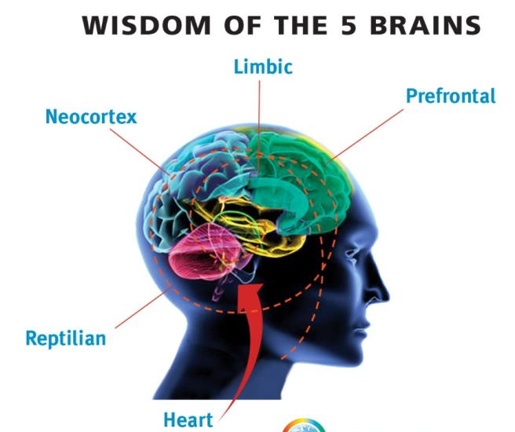
Conversational Intelligence by Judith Glaser
Notes:
Notes/Ideas
Key Takeaways
Ideas for Application

Slide 11
Conversational Intelligence by Judith Glaser
Notes:
Notes/Ideas
Key Takeaways
Ideas for Application

Slide 12
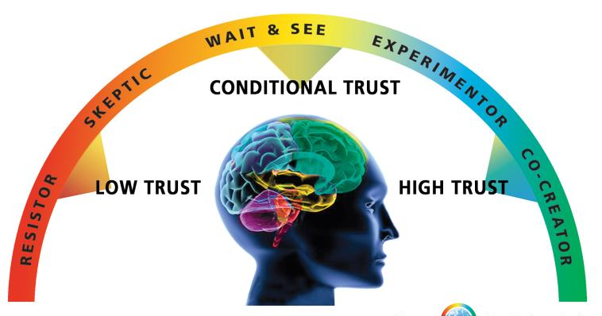
Conversational Intelligence by Judith Glaser
Protect
Partner
Notes:
Notes/Ideas
Key Takeaways
Ideas for Application

Slide 13
Notes:
Notes/Ideas
Key Takeaways
Ideas for Application

