Slide 1
Mommies Program – Outpatient Treatment NAS Residential Treatment
Briseida Courtois, MSSW, LCDC
Director of Substance Use Treatment Services
The Center for Health Care Services

Slide 2
Definition of Addiction
Addiction is a primary, chronic disease of brain reward, motivation, memory and related circuitry. Dysfunction in these circuits leads to characteristic biological, psychological, social and spiritual manifestations. This is reflected in an individual pathologically pursuing reward and/or relief by substance use and other behaviors.
Addiction is characterized by inability to consistently abstain, impairment in behavioral control, craving, diminished recognition of significant problems with one’s behaviors and interpersonal relationships, and a dysfunctional emotional response.
Like other chronic diseases, addiction often involves cycles of relapse and remission. Without treatment or engagement in recovery activities, addiction is progressive and can result in disability or premature death.

Slide 3
Opioid Use Among Pregnant Texas Women
Opioid use among pregnant women has increased in Texas, and approximately 1 out of 4 pregnant women admitted to DSHS-funded treatment services are dependent on opioids.

Slide 4
Neonatal Abstinence Syndrome (NAS)
Withdrawal that follows in-utero substance exposures
60-94% of opioid exposed infants
Neurological
Irritability
Increased wakefulness
High-pitched cry
Tremor
Increased muscle tone
Hyperactive deep tendon reflexes
Frequent yawning
Sneezing
Seizures
Gastrointestinal
Vomiting
Diarrhea
Dehydration
Poor weight gain
Poor feeding
Uncoordinated and constant sucking
Autonomic
Diaphoresis (profuse sweating)
Nasal stuffiness
Fever
Mottling
Temperature instability
Piloerection (goose bumps)
Mild elevations in respiratory rate and blood pressure

Slide 5
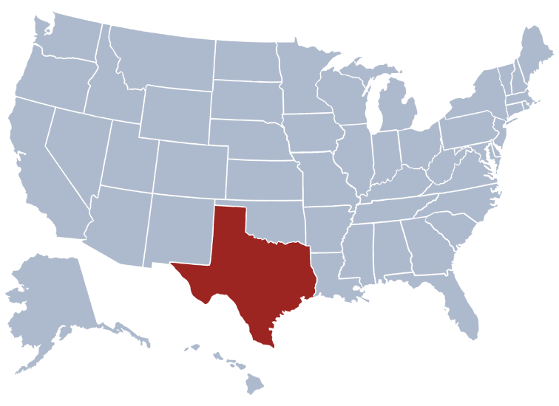
2014 Texas Medicaid NAS Births Data
Average length of hospital stay was 21 days
Average cost for hospital stay was $32,000
Counties with the highest incidence:
Bexar 26%
Dallas 14%
Tarrant 10%
Harris 7%
Nueces 7%

Slide 6
Cost of NAS
Associated healthcare costs for providing care for infants with NAS has risen from $190M per year to $720M per year as a result of the increasing incidences
In 2009, average hospital expenses for infants with NAS were estimated at $53,400 when compared to $9,500 for all other births
High cost is primarily due to a lengthy hospital stay in a NICU and the need for extensive nursing care
Average hospital stay for newborns with NAS is approximately 16 days when compared to 3 days for all other births
NAS also results in increased costs to the Child Welfare System through investigations, removals, and placement in foster care. For example, the cost of providing foster care for one child is approximately $25,281 per year and kinship care for children placed with family is $1,500 per year.

Slide 7
Management of Maternal Opioid Use Disorder
MAT, NOT DETOX
MAT is the use of medications, in combination with counseling and behavioral therapies, to provide a whole-patient approach to the treatment of substance use disorders
Both ACOG and ASAM recommend against medically supervised withdrawal from heroin or other opioid drugs during pregnancy because of the high relapse rate and the increased risk of fetal distress and death.
Medically unsupervised withdrawal is contraindicated

Slide 8
Mommies History
2007 – Project Cariño (“cherish” and “tenderness”) was created at The Center for Health Care Services (CHCS) through funding by a 5 year, $2.5M Substance Abuse and Mental Services Administration (SAMHSA) grant
2013 – Program was renamed the Mommies Program when UHS assumed funding for the program and partnered with CHCS
To date – Approximately 1,500 pregnant and parenting women and their families have been served by this program

Slide 9
Services
Childcare
Transportation
Credentialed Staff
Outreach Staff
Case Manager
Patient Navigator
Counselors
EB Curriculum addressing trauma
EB Curriculum addressing parenting
Life Skills Training
Sexual Health

Slide 10
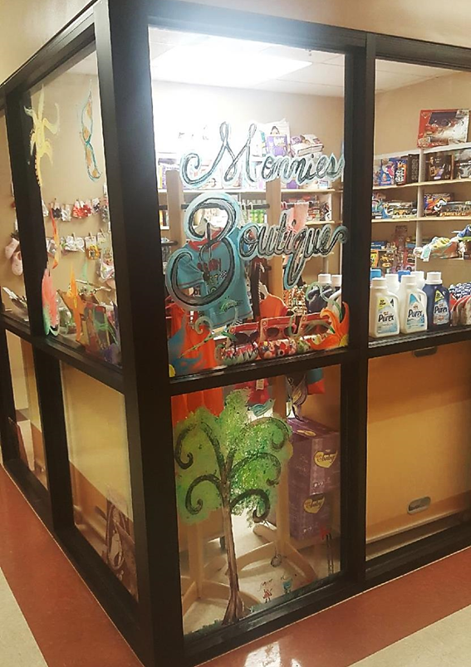
Benefit to Mommies Program Involvement
Linkage to transportation services via Logisticare (for Medicaid-funded clients), bus pass, or shuttle service (for Non-Medicaid funded clients)
Free on-site childcare while attending sessions/groups. If mother is to be supervised per Safety Plan, mother is to understand that supervisor must sign-in and sign-out child(ren) of childcare room
A benefits coordinator to assist women with enrollment in healthcare and other benefits, referrals to prenatal care and scheduling of health-related appointments
Direct referral to any other services located at CHCS Restoration Center
Mommies Boutique Shopping Incentives

Slide 11
The “Mommies”: A Healthcare Environment Culture Change
Collaboration with UHS
In-services conducted for UHS staff on reducing stigma
“Mommies” are treated like any other patient with a chronic healthcare need such as diabetes or hypertension
During encounters, are referred to as “one of our Mommies” to reduce stigmatization

Slide 12
Involvement of Hospital Staff
University Hospital staff provide educational classes at the Center for the Mommies
Provides the women with an opportunity to become familiar with the hospital staff
The curriculum consists of 13 classes on a variety of topics

Slide 13
Results
The result of reducing stigma; creating a family focused NICU environment; providing education and support to mothers; and developing a therapeutic relationship prior to delivery has shown to reduce NICU lengths of stay by 33% and 87% of newborns go home with Mommies participants
In addition, many newborns delivered by mothers in this program have symptoms that do not require hospitalization
Each year, roughly160-175 women and their children are served by the $175,000-$400,000 approximate annual cost it takes to operate the Mommies program

Slide 14
Mommies Outcomes 2017
Participation of women in the Mommies Program has resulted in a 33% reduction in infants’ NICU length of stay due to NAS
86% of mommies who completed 6 months of treatment maintained abstinence
100% of infants released to mothers’ care/custody were screened by CHCS ECI (Early Childhood Intervention) program by 8 weeks post-delivery
90% of mommies completed The Nurturing Program for Families in Substance Abuse Treatment & Recovery (EB Parenting curriculum)

Slide 15
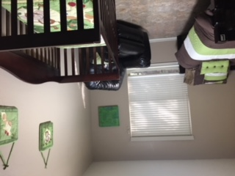
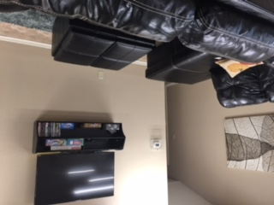
NAS Residential Treatment Program
Due to the success of the Mommies Program CHCS was selected to pilot the NAS Residential Treatment program
Funded by Department of State Health Services in response to the opioid epidemic
Has been in operation for approximately 18 months. 1st client admitted in August 2016
NAS program has admitted 94 women and serviced approximately 15 infants

Slide 16
NAS Residential Outcomes 2017
65% of the women in NAS RTP completed 90 days of treatment
60% of the women were working towards family reunification after successfully completing recommended length of stay
90% of the women were able to have regular visitation with their children as court ordered and were transported weekly to these visits
80% of the women were able to have parent/child visitation at the CPS office
80% of the women were able to bring their newborn to treatment when released from the hospital

Slide 17
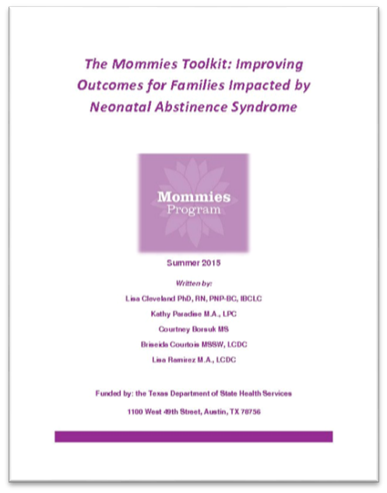
References
The Mommies Toolkit: Improving Outcomes for Families Impacted by Neonatal Abstinence Syndrome,” Summer 2015, www.dshs.texas.gov/sa/NAS/Mommies_Toolkit.pdf
Texas Department of State Health Services: Texas Strategies to Address the Opioid Crisis and Neonatal Abstinence Syndrome
The Center for Health Care Services Outpatient Specialized Female Treatment (Mommies Program) Client Handbook (Rev. 03/29/2017)
American Society of Addiction Medicine (ASAM)

