Slide 2
CSR Communication Strategy: Using Communication Channels and Message Development to Impact Employee Performance in LHDs
Jeniece L. Carter
NFBPA ELI 2017-2018
April 17, 2018

Slide 3
George Bernard Shaw
“The single biggest problem with communication is
the illusion that it has taken place.”
Notes:
Ice Breaker – What if we treated people the same way we treated email?
Kellen (Delete) and Amanda (Corporate Clapback)

Slide 4
Problem Statement:
Local health departments (LHDs) with ineffective communication channels result in workplace conflicts, distorted information, and decreased employee engagement and performance.
Notes:
According to a 2014 communications study, a business of 100 employees spends an average of 17 hours a week clarifying lousy communication.
Poor message
Bad Channel
Out of context

Slide 5
Why it Matters…
Who and what does communication impact
Current State | Future State
Operate independently | Collaboration and partnership
Conversation avoidance | Correspondence baselines
Disengaged Employees | Inc. Engagement; Inc. Retention
Disconnect from central mission | Awareness, buy-in, and advocacy
Weak structural vocabulary | Intentional vocabulary

Slide 6
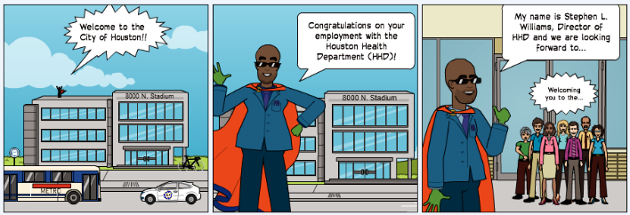
Methodology
Trial (Test) Balloon
Graphic illustration
Survey/Focus group
SWOT Analysis
Focus groups
Human resource data
Communication Consultation
Message Mapping
Interviews

Slide 7
Analysis
Findings
Weaknesses - Communication
Communication Internal (employees) Vertical Horizontal
Policies, Processes, Procedures Unclear Nonexistent
Message Mapping
Internal Platforms Inbound Email, Newsletters, Meetings
*Communication-related activity = 191
*Concept References to the action of communicating
Notes:
About 2000 unique (2/3 include the, and, to, etc)

Slide 8
Alternative
Introduce CSR Communication Strategy: CSR market brand communication enables business operations to create shared value amongst employees by sharing its goals, progress and achievements with them.

Slide 9
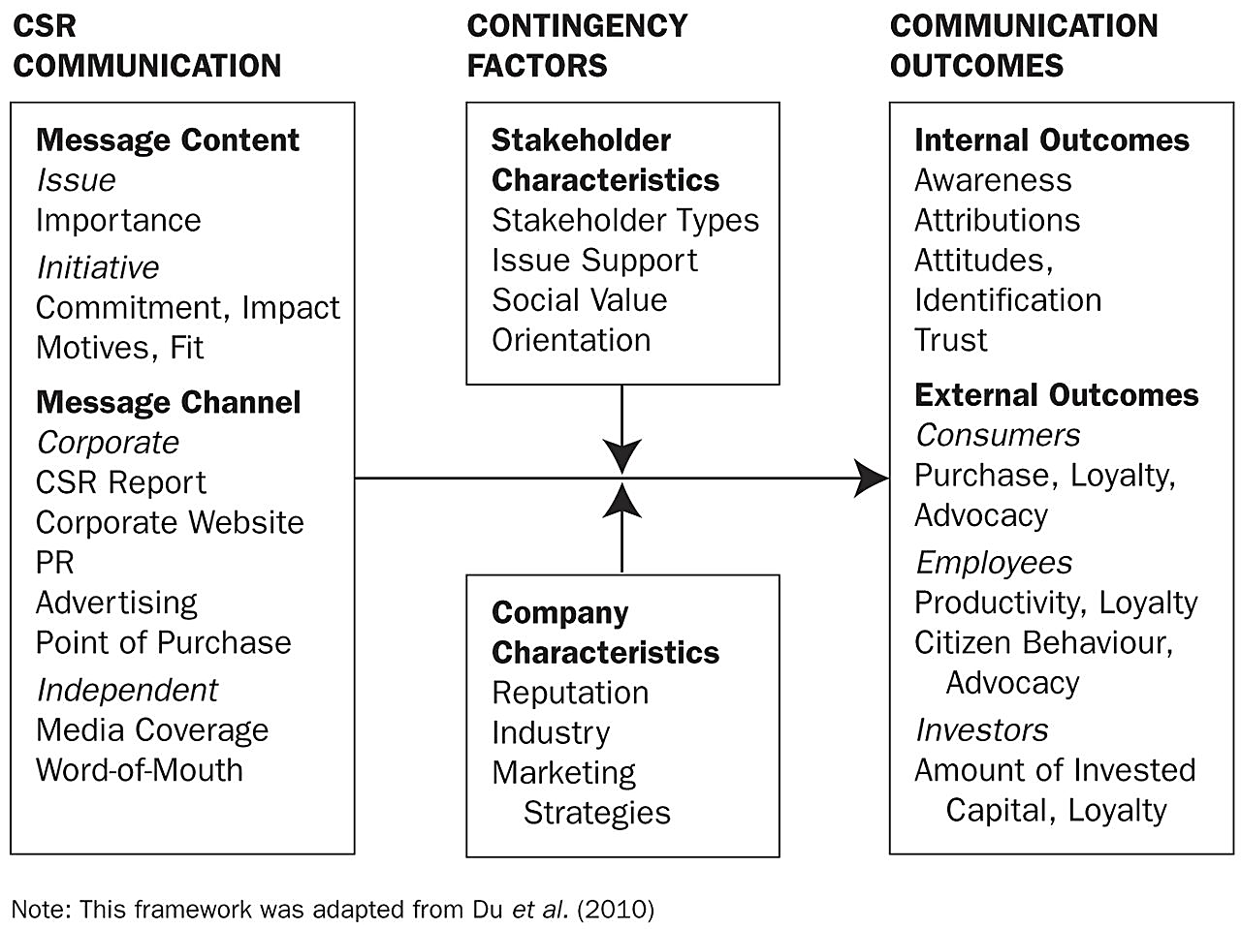
CSR Communication Strategy
CSR Communication Strategy
Corporate social responsibility(CSR) communication can be perceived as a reaction to the ongoing process of societal change and making those initiatives sound like it matters.

Slide 10
Logic Model
Potential for favorable outcomes
Inputs
Intervention
Outputs
Outcomes
Short-term
(Primary)
Medium
Long-term
(Secondary)
Facilities
HHD Programs
HHD Employees
IT Analysts
Email
Phone
Data/Research
Communication Officer
Marketing team
Performance management
CSR Strategy
Message Development
Website mgmt.
Adopt best practices
Email analytics
LSS process improvement
Channel Filters
Message Development
Baseline metrics
Reports
Org. analysis
Organizational mgmt. strategies
Collaboration
Inc. email open-rate
Inc. engagement
Enhanced communication
Inc. morale
Inc. Buy-in
Awareness
Inc. Advocacy
Inc. social value
Internal
Inc. morale
Emp. Retention
Accreditation
External
Program Loyalty
Service value
Sustainability
Background:
A business of 100 employees spends an average of 17 hours a week clarifying bad communication.
LHDs are tasked with communicating scientific information to non-scientific audience.
Communication plays a vital role in behavioral change and public health outcomes.
PDP Solutions. (2012). Cost of Poor Internal Communications 2014. Retrieved from https://www.slideshare.net/ldickmeyer/cost-of-poor-internal-communications-912

Slide 11
Logic Model: Implications
Ethics and Bias
Relationships
Resources
Ensuring communities benefit from the research practices
Equal voice and disclosure
Reciprocity of shared goals
Process evaluation
Internal Conflict
Authority
Respect
Monitor/evaluate working relationships
Recognizing the true cost of participation and dissemination
Equitable recognition and incentives

Slide 12
Recommendations
Develop CSR communication strategy to improve upon existing resources.
Implement message development and pre-testing.
Create communication baselines.
Perform organizational network analysis (ONA).
Merrill, J., Keeling, J. W., & Carley, K. M. (2010). A Comparative Study of 11 Local Health Department Organizational Networks. Journal of Public Health Management and Practice, 16(6), 564-576. doi:10.1097/phh.0b013e3181e31cee
Notes:
Organizational network analysis (ONA) is an extension of social network analysis that is used to study organizational dynamics. ONA draws conclusions about an organizational behavior by examining the relationships among employees and their work and interpreting these with social and management theory. (The relationships between) people and work.
Conclusions: Shared network patterns across LHDs suggest where common organizational management strategies are feasible.

Slide 13
Acknowledgments…
I would like to express my gratitude and appreciation for all of the individuals, teams, and programs that contributed resources, support, and data for the completion and presentation of this experience.
National Forum of Black Public Administrators (NFBPA)
Marcia L. Conner, Executive Director ELI
2017-2018 ELI Cohort
Houston Health Department
Stephen L. Williams, Director
Benjamin Hernandez, Assistant Director ASD
Kellen Sweny, Sponsor, Registrar Bureau of Vital Statistics
Scott Packard, Chief Communications & Public Affairs Officer
OPERE/OPM

