Slide 1
Workforce and Economic Development Moving to Self-Sufficiency
Moderated by Reba Bacon, Project Development Specialist,
Office of Employer Initiatives, Texas Workforce Commission

Slide 2
Good Neighbor Ambassador Program
Constance T. Haqq Director of Administration & External Affairs

Slide 3
Good Neighbor Ambassadors
About the Northeast Ohio Regional Sewer District
Beginning: Program origin and purpose
Program design and successes
Questions and answers

Slide 4
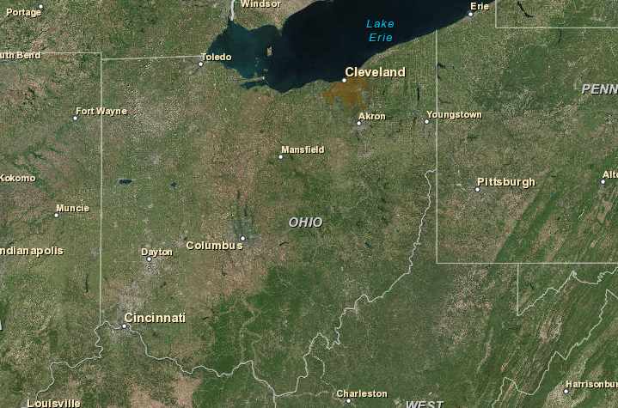

Slide 5
About the @neorsd
Political subdivision of Ohio
Created in 1972 by Court Order
62 member communities including City of Cleveland
One million residents

Slide 6
About the @neorsd
3 award-winning treatment plants
Treat 90 billion gallons annually
State-certified laboratory
330+ miles of sewer, 420-mile stream network
$200+ million annual capital program

Slide 7
$3 billion, 25 years
Combined sewer overflow control
Sewer fees
$41 million annually
Flooding & erosion
Impervious surface fee

Slide 8
Beginning: Program origin, purpose
Establish presence
Raise awareness
Build trust
Provide opportunity
Established 2013

Slide 9
Program design
Ambassadors must:
Have familiarity with the neighborhoods in which we work
Have a high school diploma or GED
Be employed or underemployed

Slide 10
Program design
Ambassadors are:
Employees of @neorsd with full benefits
Working 30 hours each week

Slide 11
Program design
Ambassadors tasks include:
Site cleanup, maintenance, mowing/weeding
Outreach activities
Assistance around the neighborhood

Slide 12
Program design
Ambassadors receive:
Job site tours
Presentations by job and academic recruiters
Job readiness assessments
12 sessions of Soft Skill Training
Host of additional training opportunities

Slide 13
Program successes
Through April 5, 2018:
37 total GNA participants
8 terminated
7 in current Ambassador cohort
22 obtained full-time employment

Slide 15
Cuyahoga community college
Tri-C® Where futures beginSM
April 20, 2018
Marquita L. Rockamore, MAML, GCDF
Notes:
Section heading: Good afternoon, My name is Marquita Rockamore and I am the Director of Healthcare Industry Solutions in the Workforce Community and Economic Development Division (WCED) of Cuyahoga Community College, also know as Tri-C.

Slide 16
WORKFORCE COMMUNITY AND ECONOMIC DEVELOPMENT DIVISION
Notes:
WHO IS TRI-C?
Cuyahoga Community College (Tri-C) opened in 1963 as Ohio's first community college and remains Ohio's oldest and largest public community college.
For more than 50 years Tri-C has provided high quality, affordable education and programs to more than 900,000 members of our community
Tuition at Tri-C is the lowest in Northeast Ohio and among the lowest of all colleges in the state of Ohio.

Slide 17
Cuyahoga Community College (Tri-C) MISSION
Provide high quality, accessible and affordable educational opportunities and services
Promote individual development
Improve the overall quality of life in a multicultural community
Notes:
Mission
To provide high quality, accessible and affordable educational opportunities and services — including university transfer, technical and lifelong learning programs —that promote individual development and improve the overall quality of life in a multicultural community.

Slide 18
Cuyahoga community college
Equity
Success
Access

Slide 19
Career Advancement competitive edge
Notes:
Q. 1: What service does Tri-C’s Workforce, Community and Economic Development Division provide to the Northeast Ohio Regional Sewer District’s (NEORSD) Good Neighbor Ambassador (GNA) program?
For nearly six years, my primary role at Tri-C was employer engagement: conducting outreach to employers to partner with the college on workforce initiatives; networking and engaging area businesses to host student interns, promoting students’ and community members’ KSAs to employers for employment job or career opportunities; tracking, verifying, and documenting employment on graduates. Whenever an employer fired or did not hire someone the reasons, more often than not, centered around lack of professionalism. Tri-C, in partnership with a number of other businesses, social service agencies and universities developed the Career Advancement Skills workshop, which we customized for the NEORSD to create the Career Advancement Competitive Edge (CACE) workshop.

Slide 20
CAREER ADVANCEMENT COMPETITIVE EDGE
Thinking Skills
Critical Skills
Creative Skills
Decision Making
Problem Solving
Learning Styles
Reasoning Skills
Analytical Skills
Personal Qualities
Responsibility
Self-Esteem
Sociability
Integrity/Honesty
Professional Work Attitude and Habits
Notes:
The Career Advancement Competitive Edge (C.A.C.E.) is an interactive workshop designed to expose the NEORSD Good Neighbor Ambassadors to essential customer service, professionalism and career advancement skills. Through a series of instructional modules, discussions, handouts, behavioral modeling and activities that include role play, students have the opportunity to learn, observe, and develop customer service skills and practice professionalism. In addition to this workshop we offer essential wraparound supports to include a career interest inventory, aptitude assessment, career coaching, résumé preparation and behavioral-based interview practice.

Slide 21
CAREER ADVANCEMENT COMPETITIVE EDGE
Skills for the Workplace
Communication
Teamwork
Adaptability/Flexibility
Organizing and Task Completion
Time Management
Problem Solving
Punctuality and Attendance
Leadership
Customer Service
Self-Management
Cultural Fit
Interpersonal Relations
Self Promotion
Appearance
Notes:
EDUCATIONAL OUTCOMES
As a participant of the Career Advancement Skills Competitive Edge Workshop, the NEORSD Good Neighbor Ambassadors is registered as a student at Cuyahoga Community College (Tri-C), receive a Tri-C student identification number and obtain a student picture I.D. The Ambassadors have access to all of the benefits and services available to students, i.e. the library, gym, Tri-C student discounts, bus tickets, etc.
Upon successful completion of the course modules, students will demonstrate an increase understanding of:
The importance of a wide array of skills that are essential for career advancement
The consequences of not having these skills or not putting them into practice
The ways these skills are used in the workplace in real life situations

Slide 22
C.A.C.E. and Bridges out of poverty
No significant learning occurs without a significant relationship.
–Dr. James Comer
Notes:
However, when working with students who are in generational poverty we understand that no significant learning occurs without a significant relationship – Dr. James Comer. Trust and relationships are key.
As the primary instructor of the CACE workshop to the Ambassadors, I noticed an heightened lack of understanding to the seemingly well known rules of workplace etiquette. The outlook, experiences, responses, and behaviors of the participants prompted me to become further trained in the Bridges Out of Poverty philosophy.
(For reference only: The Comer School Development Program (SDP) began in the two lowest income and lowest achieving elementary schools in the city, 32nd and 33rd of 33 in 1968. Child psychiatrist James P. Comer, MD, MPH and a team of Yale Child Study Center colleagues worked with the two schools that eventually rivaled the city's highest income schools, had the best attendance record, and no serious behavior problems. Over the past nearly 50 years numerous schools have used SDP similarly to close the achievement gap. The SDP model has been implemented in more than 1000 schools in 26 U.S. states, the District of Columbia, Trinidad and Tobago, South Africa, England, and Ireland.)

Slide 23
Bridges out of poverty
A philosophy that uses the lens of economic class to provide concrete tools and specific strategies to prevent, reduce and alleviate poverty
Notes:
Q. 2. Can you share with us what is Bridges Out of Poverty?
Bridges Out of Poverty is a philosophy that uses the lens of economic class to provide employers, educational institutions, community organizations, social agencies and individuals with the concrete tools and specific strategies to prevent, reduce and alleviate poverty. For the purposes of this framework, we define poverty as “the extent to which an individual lives without resources.” – Dr. Ruby Payne
Doing without resources includes financial, emotional, mental, spiritual, physical, support systems, relationships and role models, and the hidden rules of a group.
aha! Process’s Bridges Out of Poverty community support program provides a family of concepts, workshops, and products to help employers, community organizations, social service agencies, and individuals address and reduce poverty in a comprehensive way. Bridges brings people from all sectors and economic classes together to improve job retention rates, build resources, improve outcomes, and support those who are moving out of poverty.

Slide 24
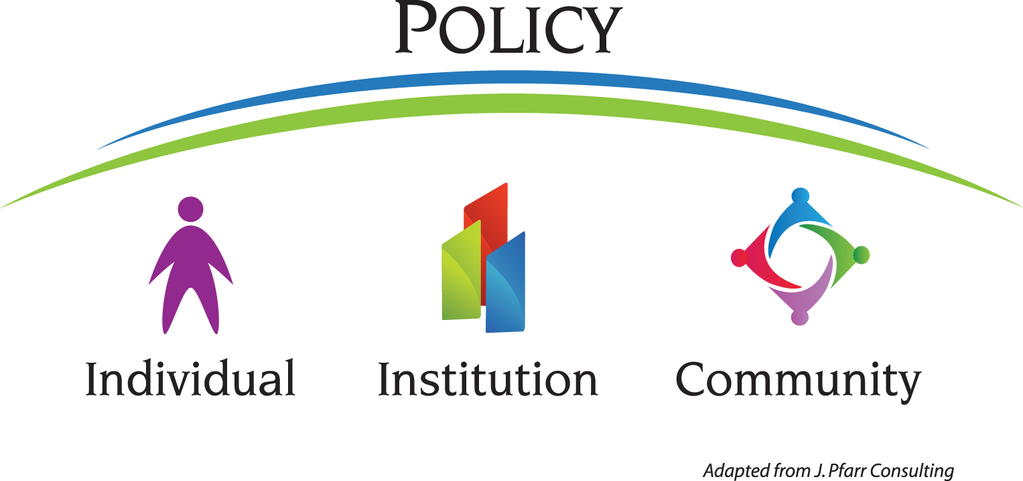
Viewing economic class issues through the “Triple lens”
Copyright J. Pfarr Consulting
Notes:
The Bridges work is intended to be used at all of these levels: individual, institution, community, and policy. We call these the four lenses through which you can view and use the Bridges information as represented in the Community Sustainability Grid, Appendix H (and discussed on pp. 28–30) in Facilitator Notes for Getting Ahead in a Just-Gettin'-By World (DeVol, 2006).
There are two objectives with the mental model on this page. The first is to have every participant view the material in all four ways. Every participant will have their “favorite” lens or way that they like to view the material. For example, some of us spend 98% of our job working with individuals, so when we go to training or receive new information like the Bridges material, we are asking, “Now, how do I use this information when I am working directly with a person?” The Bridges individual track will give you specific tools that will assist you with this level.
As a person gets promoted, their “favorite” lens often changes to the institution lens. Now, when we receive new information, we are not thinking about how we use this at an individual level, but rather how we can use this to change the way our program is set up, to adjust how our institution operates. The institution track will give you concrete methods and ideas of how to use the Bridges information at this level.
Still, some of us consider ourselves community advocates, and we want to know how we use this information at a community level. There are communities throughout the country and in other countries using the Bridges information. The community track will give examples and ideas of how to use this at a community level.
If we use the Bridges material at the individual, institution, and community level, then often policies begin to change. Policies include policies that run your program, all the way up to federal policies (program, institution, city, county, state, and federal are all included in policies). This is why it is a large arch over the other three.

Slide 25
Bridges out of poverty
Tri-C, NEORSD, and the Good Neighbor Ambassadors
Establish, build, and guard relationships of mutual respect
Co-investigate realities together
Bring insights from all economic classes
Notes:
Facilitating the Career Advancement Skills workshop from the Bridges Out of Poverty framework allows the Tri-C facilitator, NEORSD, and the participants to establish, build, and guard relationships of mutual respect. Mutual respect fosters a deeper learning.
In Bridges we refer to the participants as investigators. Tri-C, the administrative team of the NEORSD GNA program listen to and hear one another. Through this intentional and purposeful communication the investigators (individual), the college (institution) and the employer (business community) co-investigate the realities of their relationship, bringing insights from all economic classes.

Slide 26
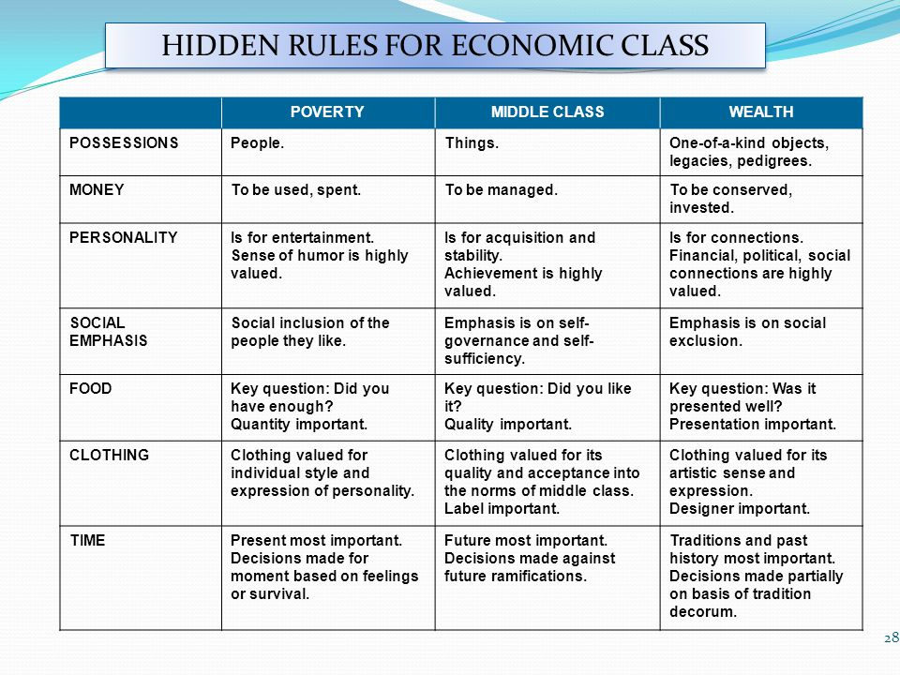
Notes:
Hidden Rules for Economic Class: Hidden rules are the unspoken cues and habits of a group. – Dr. Ruby Payne They are hidden because they are not written. If workplace etiquette is built on middle class norms, how are members of other economic class exposed to these norms.
Tyranny of the moment: The Bridges theory: When individuals are under-resourced to the extent that they spend too much time and energy keeping their heads above water, they fall into the tyranny of the moment. Rather than spending time and energy on building resources for a better future, their time and energy goes into trying to stabilize a destabilized world. In that way, they end up simply maintaining a life of poverty. This constant crisis makes it difficult for people in poverty to build a future story.

Slide 28
Bridges out of poverty
OUTCOMES
Strengthen educational attainment and job skills
Improve on-the-job productivity
Connectedness
Improved retention
Building sustainable communities
Notes:
Q. 3. How has the Bridges approach framework impacted the outcomes of the Good Neighbor Ambassadors?
Strengthen educational attainment and job skills: Within each cohort, I have experienced GNA’s who express no desire to enter a training or degree program at the start of the CACE workshop, not only express an interest but start the enrollment process. Others even begin class.
Improve on-the-job productivity: Exposing the Good Neighbor Ambassadors to the Hidden Rules of Economic Class helps them to investigate the lens of the employer, board of trustees and other stakeholders.
Connectedness through environmental responsibility: The neighborhood revitalization skills (landscaping and clean-up of lots) provide the GNA’s with skills on the uses of lawn equipment and tools they may not possess, nor be familiar, nurtures a sense of community, and promotes responsibility and accountability for the aesthetics of their neighborhoods, the quality of their water, and pride in caring for all of the above.
Improved retention: Provide numbers from NEORSD

Slide 29
Commissioner Julian Alvarez
Texas Workforce Commission

Slide 30
Texas Workforce Commission
Mission –
To promote and support a workforce system that creates value and offers employers, individuals, and communities the opportunity to achieve and sustain economic prosperity.
Vision –
Maximize the power of innovation and partnerships to boost superior business outcomes and realize a competitive advantage for all Texans in the global economy.

Slide 31
Texas Workforce Commission

Slide 32
Apprenticeship TEXAS
BUILD a highly skilled workforce
PREPARE for a retiring workforce
EARN business tax credits
RETAIN qualified workers
REDUCE turnover costs with a positive return on investment

Slide 33
JET
Jobs and Education for Texans Grant Program
A grant to purchase and install equipment necessary for the development of career and technical education courses that lead to a license, certificate or post-secondary degree in a high-demand occupation.
$10 million available biennium
6 – Member Advisory Board

Slide 34
Self - Sufficiency Fund
Provides training grants to community and technical colleges and community-based organizations (501 (c)(3)) who deliver training that will lead to industry recognized certifications and permanent full-time employment for adult recipients.
Awarded grant amount up to $500,000

Slide 35
Ss SELF SUFFICIENCY FUND
Targeted Industries:
Advanced Technologies & Manufacturing
Aerospace & Defense
Biotechnology & Life Sciences
Construction, Logistics & Transportation
Information & Computer Technology
Petroleum Refining & Chemical Products
Energy

Slide 36
Ss SELF SUFFICIENCY FUND

Slide 38
Workforce and Economic Development Moving to Self-Sufficiency
Moderated by Reba Bacon, Project Development Specialist,
Office of Employer Initiatives, Texas Workforce Commission

