Slide 1
Effectively Communicating Up the Ladder
T.C. Broadnax
Dallas City Manager
April 19, 2018

Slide 2
Effective Communication

Slide 3
Importance of Effective Communication
No room for misunderstanding
Positive interactions
Increased confidence
Strengthens team dynamics

Slide 4
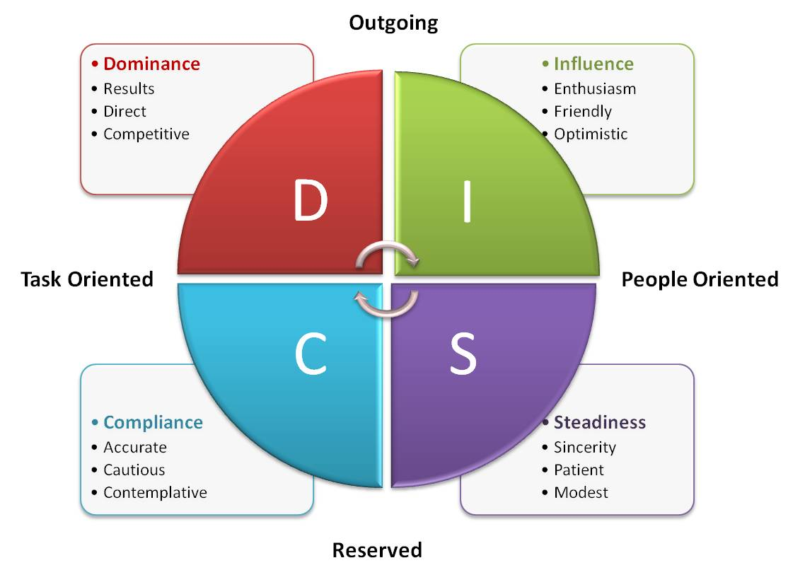
Communicating with Superiors

Slide 5
Communicating Up
Timing is Important
Own Your Mistakes
Defend Your Position
Pick A Side
Be Overly Prepared

