Slide 1
Government Governance
Why leadership will miss out on the most talented millennials to govern

Slide 2
Recruiting the next generation of leaders
The most memorable and impactful moments for employees will be upon entry and exit.
This is where expectations are formed, and final impressions remain

Slide 3
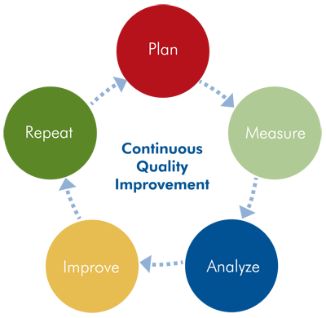
Quality Initiatives Lifecycle
Plans for Recruitment
Top colleges and universities
Job fairs
Poaching from top employers.
Common Quality Issues:
The necessary data does not exist.
The data quality is poor.
The modeling results does not reveal anything useful
Systematic bias is identified in the data sources.
Common Corrections:
Stakeholder Interviews
Data Quality at the Source!
Incremental Results and Evaluation
Everything is iterative, Nothing is static!

Slide 4
City of Crayons (COC) Avg. Recruitment Timeline
Approximate amount of time from submission of application to employee start date is one year!
Most promising scenario with all hands on deck is 4 – 6 months
Opportunity cost of this process?
Loss of most competitive talent

Slide 5
selected Perks from a top company
Free meals and cooking classes
Onsite gyms and free workout classes
30 days vacation and 3-month sabbatical option
Tuition Reimbursement
Working from home*
Expectation of work/life balance
Investment in employees leads to job satisfaction in a supportive environment as an expectation.

Slide 6
A personal Example
After deciding to pursue a new opportunity, my experience with COC was:
Immediately removed from all team meetings
Cordial coldness
Enforcement of rules on the books, but “selectively” Enforced
Tuition reimbursement – theft vs. invoicing

Slide 7
Soft bigotry of Low expectations
No person or culture can be solely judged by its imperfections
“Racism is not merely a simplistic hatred. It is, more often, broad sympathy toward some and broader skepticism toward others.”
-Ta-Nehisi Coates

Slide 8
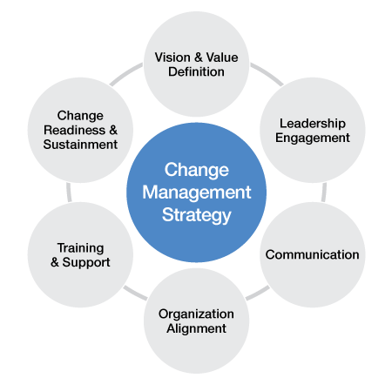
Change Management Strategy
Un-Freeze
Rationale for Change
Prepare Employees
Why must this Change Occur?
Change
Close Communication
Close Proximity
Align, Align, Align (Stakeholders and Employees)
Re-Freeze
Monitor Processes
"the old ways are better!"
Sustain the Change

Slide 9
Thank you!

