Slide 1
It’s GREAT to be Number Two!
Track 4 – Friday, April 20 – 10:15 a.m.
Presented By
Jovan Grogan
Janice Napper
Keena Smith
Karen Pinkos

Slide 2
Presentation Credit: Kristen Nelson and Wade McKinney, City of Indian Wells, CA!

Slide 3
ROLES & GOALS
RELATIONSHIP BUILDING
BENEFITS
TENSION
SKILLS
$100
$100
$100
$100
$100
$200
$200
$200
$200
$200
$300
$300
$300
$300
$300
$400
$400
$400
$400
$400
$500
$500
$500
$500
$500

Slide 4
RESPONSIBILITY, LEADERSHIP, SUPERVISORY OPPORTUNITIES

Slide 5
ROLES & GOALS
RELATIONSHIP BUILDING
BENEFITS
TENSION
SKILLS
$100
$100
$100
$100
$100
$200
$200
$200
$200
$200
$300
$300
$300
$300
$300
$400
$400
$400
$400
$400
$500
$500
$500
$500
$500

Slide 6
AUTHORITY, BUT…

Slide 7
ROLES & GOALS
RELATIONSHIP BUILDING
BENEFITS
TENSION
SKILLS
$100
$100
$100
$100
$100
$200
$200
$200
$200
$200
$300
$300
$300
$300
$300
$400
$400
$400
$400
$400
$500
$500
$500
$500
$500

Slide 8
99 PROBLEMS

Slide 9
ROLES & GOALS
RELATIONSHIP BUILDING
BENEFITS
TENSION
SKILLS
$100
$100
$100
$100
$100
$200
$200
$200
$200
$200
$300
$300
$300
$300
$300
$400
$400
$400
$400
$400
$500
$500
$500
$500
$500

Slide 10
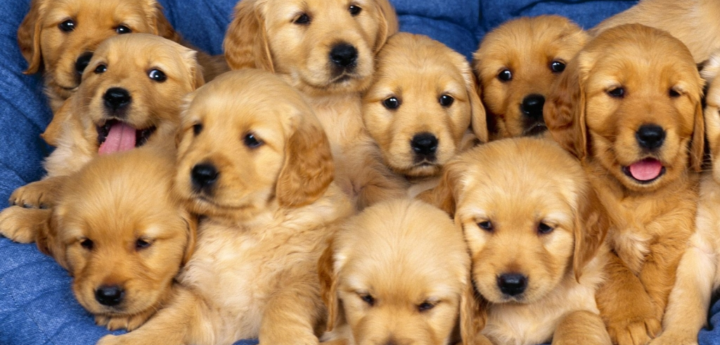

Slide 11
ROLES & GOALS
RELATIONSHIP BUILDING
BENEFITS
TENSION
SKILLS
$100
$100
$100
$100
$100
$200
$200
$200
$200
$200
$300
$300
$300
$300
$300
$400
$400
$400
$400
$400
$500
$500
$500
$500
$500

Slide 12
AUDIENCE ASKS

Slide 13
Final Jeopardy! (Q & A)

Slide 14
It’s GREAT to be Number Two!
THANK YOU!
JGrogan@cityofberkeley.info
JNAPPER@auroragov.org
kmsmith@franklincountyohio.gov
kpinkos@ci.el-cerrito.ca.us

