Slide 1
Ending HIV the Epidemic:
A Look at Washington, D.C.’s 90/90/90/50 Plan
Denise T. Lucas, MSA
Sanitarian, District of Columbia Department of Health
2017-2018 NFBPA Mentor Program Protégé

Slide 2
abstract
2016
Nearly 13,000 DC Residents Living with HIV
1.9% of the City’s Overall Population
Epidemic Status = 1% of a Population
Mayor Muriel Bowser Announced the Development of the 90/90/90/50 Plan
The ambitious plan was developed through the collaboration of the
DC Department of Health
Washington AIDS Partnership
DC Appleseed
Goal = Removing the District’s Epidemic Status by the year 2020

Slide 3
Project goals & Methodology
Methodology
Project Goals
Quantitative and Qualitative research, using historical data as well as exploring future program strategies
Highlight and review the components of the District’s 90/90/90/50 program, its goals, and how the program actually works
Identify which demographic group, among Washington, DC residents is most affected by HIV
Identify and discuss the strengths and weaknesses of the 90/90/90/50 program (Specifically Goal 4)
Identify areas for improvement and/or enhancement of the program
Include recommendations that could improve or enhance the current program

Slide 4
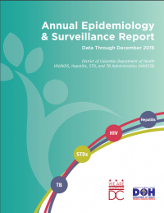
The Face of HIV in the district of Columbia
2017 DC Annual Epidemiology and Surveillance Report
African-Americans accounted for the majority of those living with HIV at the end of 2016
3.1% of all African-Americans
Black Males
1.2% of Hispanic/Latino
0.9% White/Caucasian
Residents ages 40 and above are disproportionately impacted by HIV
Living with HIV:
3.7% of residents ages 40-49
5.2% of residents ages 50-59

Slide 5
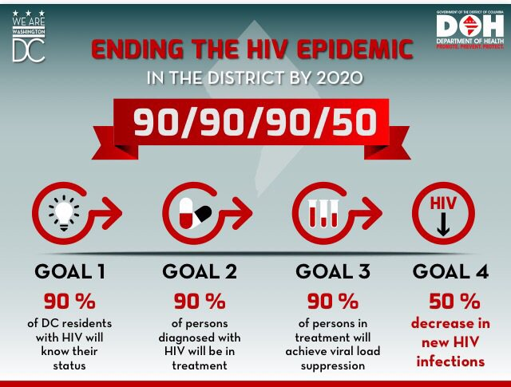
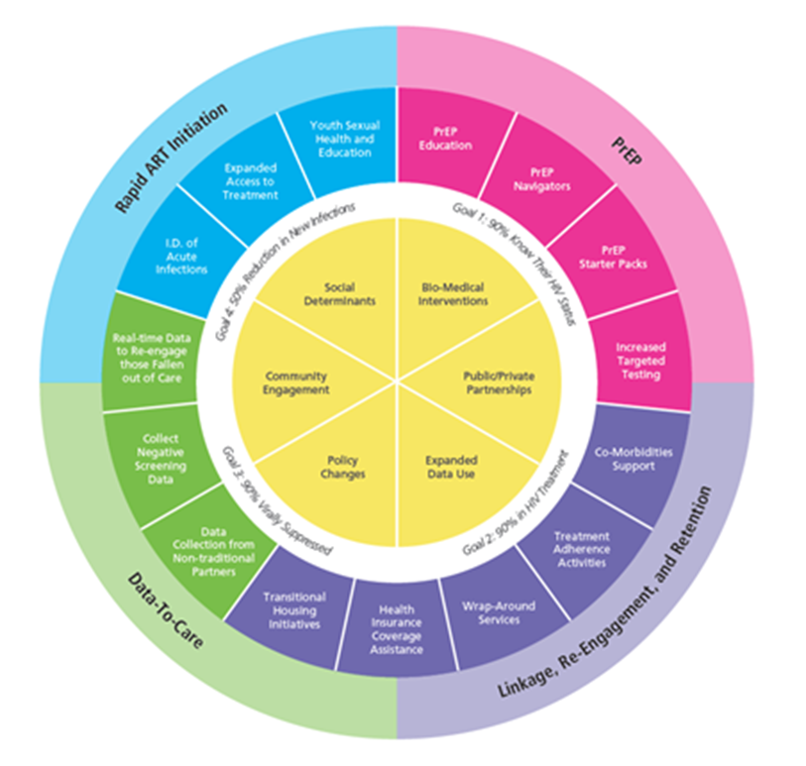
What is 90/90/90/50?
4 Goals
90% of HIV-Positive District Residents Know Their Status
90% of District Residents Diagnosed with HIV are in Treatment
90% Reach Viral Load Suppression
50% Reduction in New HIV Infections
To be achieved by the year 2020

Slide 6
DC’s 90/90/90/50 Plan At-A-Glance
The plan also focuses greatly on:
Access to Treatment
PrEP
Pre-Exposure Prophylaxis
Targeted Testing
Red Carpet Entry Program
Accelerated initiation of treatment
The Extensive 90/90/90/50 Plan Consists of:
4 Goals, which include:
42 Specific Tasks, and
7 Demonstration Projects
The overall plan focuses on the concept of Health Equity as it relates to issues such as:
Housing,
Employment,
Insurance Coverage,
Stigma, and
Education

Slide 7
Project Focus Goal 4: Reduce the new infections by 50%
Strengths
Goal 4 Focuses on:
HIV Prevention Continuum monitoring bio-medical
Reduction in behavioral risks:
Needle Sharing
STD Reinfection
Bio-medical Interventions:
Needle Exchange Programs
PrEP (Pre-Exposure Prophylaxis)
PEP (Post Exposure Prophylaxis)
STD Treatment Verification
Improves Public Education
Raises Awareness of Prevention Strategies
Reducing Stigma
Ensures that schools meet the obligations of the Healthy Schools Act
Student Education in HIV Prevention
Weaknesses
No specific details regarding methodology that will be used to determine is the schools are in compliance with the Healthy Schools Act
No system presently in place that determines if the students understand the education being provided
Lacks mention of an avenue to provide or expand access to prevention tool such as PrEP, PEP, and condom in schools for students

Slide 8
Plan Recommendations
Develop assessment/evaluation process for the effectiveness of the school based sexual health and wellness education program/curriculum.
Includes an individual assessment of the teachers providing the education
Maintain a level of accountability for schools and educators
Use assessments/evaluation as a tool for developing or updating program content and education strategy
Expand/improve access to PrEP starter kits, PEP and condoms in schools without health insurance
Allow parental consent for under-aged students to also receive access to HIV preventive medications in the school setting
Task 4.8: Create public education campaigns directed to target youth and high risk groups
Social Media
Public Transportation
Schools
Community Centers
Nightclubs
Bars
Other Social Settings

Slide 9
conclusion
Current statistics demonstrate the need for a plan of this caliber
Ongoing research and statistic indicate that with treatment, individuals living with HIV have an increased life expectancy
Need for a positive change in behavior to further reduce the number of new HIV infections
Current 90/90/90/50 plan’s flexibility allows for changes and improvements as the plan continues implementation and progresses
The success of this plan is dependent upon the effective collaboration of individuals from all walks of life. This especially includes:
Medical and Public Health Professionals
Educators
Politicians
Community Advocates
Religious Organizations
Parents/Families
Community At-Large

Slide 10
References
DC Department of Health, Washington AIDS Partnership, DC Appleseed. (2016). 90/90/90/50 Plan: Ending the HIV Epidemic in the District by 2020. Washington, DC: District of Columbia Department of Health.
DC DOH HIV/AIDS, Hepatitis, Sexually Transmitted Disease and Tuberculosis Administration. (2017). 2016 Annual Epidemiology and Surveillance Report . Washington, DC: District of Columbia Department of Health.
District of Columbia Department of Health. (2018, February 13). Red Carpet Entry Program. Retrieved from District of Columbia Department of Health: https://doh.dc.gov/service/red-carpet-entry-program
District of Columbia Department of Healthcare Finance. (2017, February 13). Health Care Alliance. Retrieved from Department of Health Care Finance - DHCF: https://dhcf.dc.gov/service/health-care-alliance
Division of HIV/AIDS Prevention, National Center for HIV/AIDS, Viral Hepatitis, STD, and TB Prevention, Centers for Disease Control and Prevention. (2017, May 30). About HIV and AIDS. Retrieved from Centers for Disease Control and Prevention: https://www.cdc.gov/hiv/basics/whatishiv.html
Division of STD Prevention, National Center for HIV/AIDS, Viral Hepatitis, STD, and TB Prevention, Centers for Disease Control and Prevention. (2011, January 28). HIV Infection: Detection, Counseling, and Referral. Retrieved from Centers for Disease Control: https://www.cdc.gov/std/treatment/2010/hiv.htm
The Washington Post. (2012, July 16). A look at the history of AIDS in the U.S. Retrieved from The Washington Post: https://www.washingtonpost.com/national/health-science/a-look-at-the-history-of-aids-in-the-us/2012/07/16/gJQA5WfgpW_gallery.html?utm_term=.c5cda7d1b665

