Slide 1
Breaking the barriers Zoning for the Mentally Ill
Chrishaun Smith
NFBPA Mentoring Program -- Spring 2018

Slide 2
Purpose
Reducing Zoning Restrictions on Housing for the Mentally Ill
Increased Demand for Housing
Restrictive Regulations due to Citizen Opposition
Methods to Removing Zoning Restrictions

Slide 3
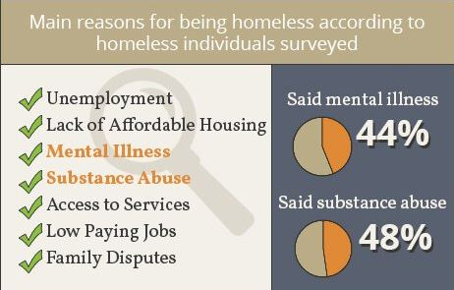
Demand for Housing for Mentally ill
Deinstitutionalization trends of housing.
Increase in homeless population.
44% of homeless in DC lack housing due to mental illness
Lack of financial resources and employment to qualify.
Lack of Access to Affordable rentals

Slide 4
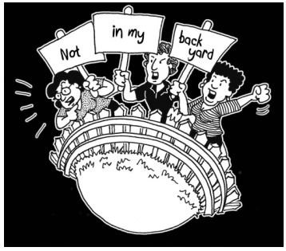
NIMBYism: Not in My Backyard
Neighborhood and citizen opposition
Common Concerns
Lower property values
Decline in business sales
Increased traffic
Increased crime
Pressure elected officials to enact stringent zoning regulations
Conditional use permits
Exclusion of uses from appropriate zones

Slide 5
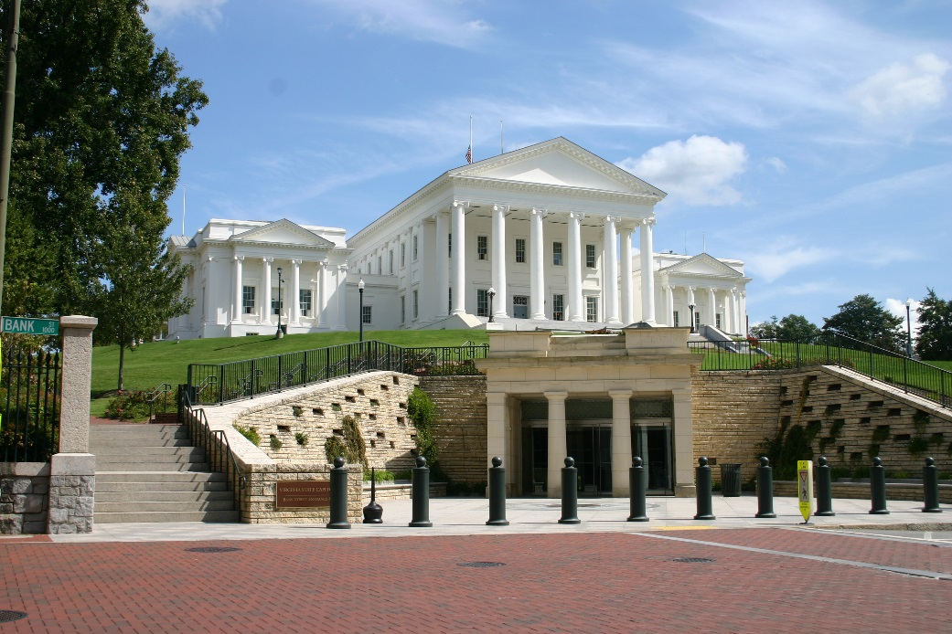
Virginia Zoning Power
Dillon Rule State
Local jurisdictions only have power expressly granted by state govt.
Required the following uses by right:
Group homes (up to 8)
Definition of a family unit at 4 unrelated persons
Zoning Power to regulate congregate housing provided to local govt.

Slide 6
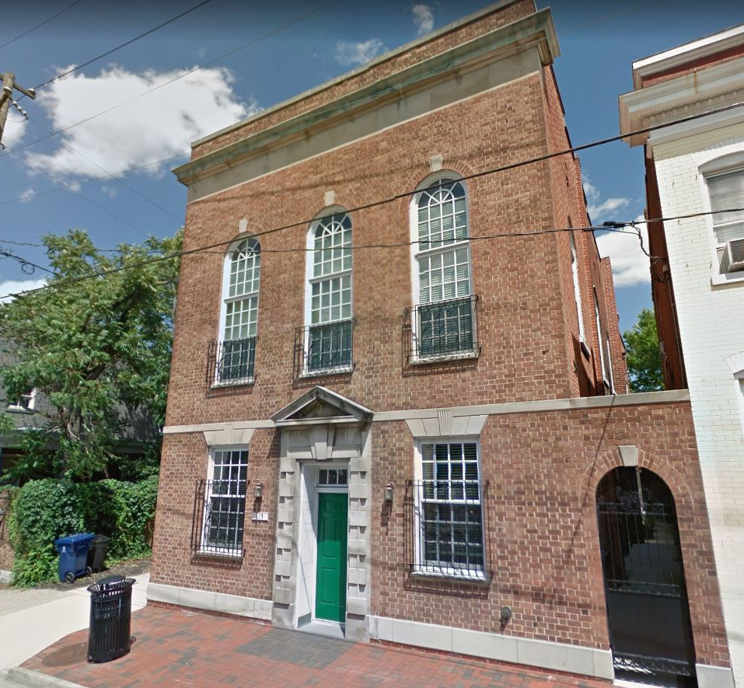
Case Study: Safe Haven - Alexandria
Transitional housing facility for mentally ill.
12 residents
Funded directly by Alexandria Community Services Board
Located within the Old Town Historic District.
Location near multiple public transportation routes
Mixed-use; high-income neighborhood

Slide 7
Case Study: Safe Haven - Alexandria
Major neighborhood opposition.
Opposition group sued to overturn original zoning decision
Determination: Special legislative approval required
Required three approval processes.
Board of Architectural Review
Planning Commission
City Council
Extensive Costs
Lawyers fees
Detailed architectural plans

Slide 8
Recommendations for Change
Amend the definition of “family”.
Increase number of unrelated individuals that could constitute a family.
Permit by-right congregate housing facilities for 10 individuals
Mid-sized units allowed by Special legislative approval in all zones that allow multi-family housing.
Changes at State level:
Creates uniform approval framework statewide.

Slide 9
Questions and Discussion

