Slide 1
The State of Mental Health in Maryland
Tiffany C. Davis, MPA
NFBPA MENTOR Program
Spring 2018

Slide 2
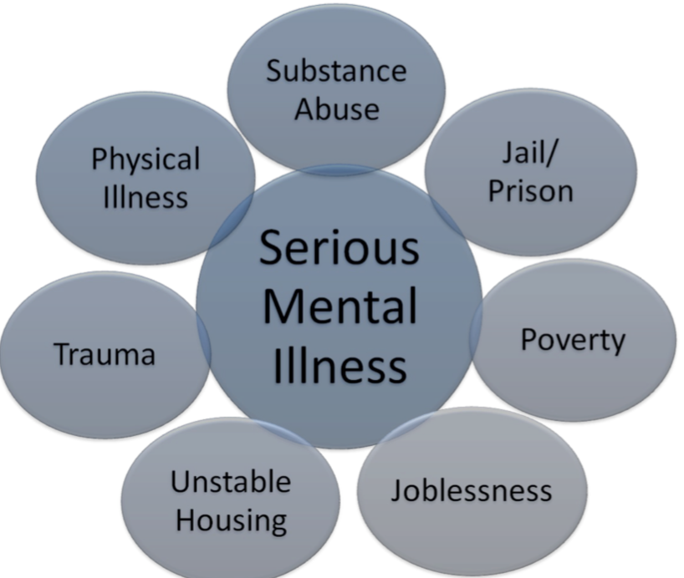
Executive Summary
Analysis of the state of mental health in Maryland:
Non-Assisted Outpatient Treatment State
Deficiencies in Care
Consequences of Non-Treatment
Strategies for Improvement

Slide 3
State of Mental Health in Maryland
Notes:
Between 2010 and 2016, Maryland closed more than 10% of its states hospitals, which is a loss of 108 beds. Consequently, since 2005, Maryland has seen a 250% increase in pretrial competency evaluations, a procedure by which the court assesses an arrested person’s mental illness and ability to participate in legal proceedings. During this evaluation period, defendants are directed to forensic patient beds, creating a game of musical chairs with treatment beds. This game leaves Maryland’s most vulnerable population, individuals with severe mental illness who have not committed a crime, without proper care or treatment.
This game has also led to increasing in-access to inpatient beds for mentally ill individuals who have not committed a crime, ultimately creating a mental health system in which criminalized mentally ill individuals receive care over mentally ill individuals who have not committed a crime. The State has consistently taken much needed state psychiatric treatment beds while population growth has outpaced availability. In 2014, Maryland had the highest rate of mentally ill patients incarcerated in the country. The statistics stated above shows how Maryland fails to effectively treat mental illness as a medical condition and instead criminalizes it. In 2016, 2,000 inmates in the United States were waiting for beds in public psychiatric hospitals.

Slide 4
Non-Assisted Outpatient Treatment State (AOT)
Assisted outpatient treatment (AOT) is the practice of delivering outpatient treatment under court order to adults with severe mental illness who meet speci c criteria, such as a prior history of repeated hospitalizations or arrest. It is a tool for assisting those individuals most at risk for the negative consequences of not receiving treatment.
MD is one of four states in the country that does not not have an Assisted Outpatient Treatment (AOT) law.
As a result:
Deficiencies in care
Consequences of Non-Treatment
Increased Homelessness
Criminalization of Mental Illness
Notes:
Like every state, Maryland has dedicated civil commitment laws that establish criteria for determining when involuntary treatment is appropriate for individuals with severe mental illness who cannot seek help on their own. Despite this commitment, Maryland is one of only four states that do not authorize involuntary treatment in the community, which is often called “Assisted Outpatient Treatment (AOT)” or “Outpatient Commitment.”
To be a candidate for AOT, a person must meet specific criteria, such as a prior history of repeated hospitalizations or arrest.
AOT laws have been shown to reduce hospitalization, arrest and incarceration, homelessness, victimization, and also to prevent violent acts associated with mental illness, including suicide and violence against others.
AOT commits local mental health systems to serve participants at the same time it commits participants to adhere to their treatment plans. Developed by patients with their healthcare providers, these plans are highly individual but typically include case management, personal therapy, medication and other tools known to promote recovery. AOT participants receive due process protections and orders are made only after a hearing before a judge.

Slide 5
Deficiencies in Care
MD has violated federal law requiring that a hospital must protect and promote each patient’s rights.
MD has enacted barriers to patients receiving care in the Emergency Department
Reliance on non-clinical staff to determine who should receive treatment,
Violated patient’s right to be free of abuse or harassment
Failed to meet standards for data collection and analysis
Failed to perform quality improvement activities.
Notes:
Dozens of mentally ill men and women who have been charged with crimes are languishing in jails across Maryland despite court orders to send them to state hospitals for evaluation and treatment. The state Department of Health and Mental Hygiene, which spurned a consultant's warning four years ago, does not have enough beds or staff to treat new patients, officials say. The shortage comes as 80 percent of those admitted to such facilities are arriving via the criminal justice system. Not enough beds
Federal regulators have cited the University of Maryland Medical Center Midtown for violating patient rights and several patient safety and hospital management regulations related to a January incident in which a woman was discharged from its emergency room in just a hospital gown.
Among the deficiencies noted in a pair of federal reports, the hospital:
Violated a federal law requiring that a hospital must protect and promote each patient's rights by failing to discharge a patient in a safe manner from the Emergency Department, and failed to protect one patient from harassment and potential harm.
Violated a patient’s right to receive care in a safe setting. “Security personnel indicated that they would turn patients away if they were ‘unruly’ or otherwise acting inappropriately. They would call police if the person did not leave. This practice meant that non-clinical personnel determined who could receive treatment in the” emergency department.
Violated patient’s right to confidentiality of records because “non-clinical staff had access to or were made aware of portions of [the patient’s] medical history and physical examination findings.”
Failed to meet standards for data collection and analysis.
Failed to perform quality improvement activities.

Slide 6
Consequences of Non-Treatment
Homelessness
At least 3,000 people in Baltimore will suffer from homelessness on any given night, tallying to over 30,000 people a year.
Throughout Maryland, over 50,000 people will experience homelessness annually.
40% of homeless individuals report having mental illness
Criminalization
Mentally ill inmates remain in jail longer than other inmates.
Incarcerating mentally ill inmates is costly.
Mentally ill inmates create behavioral management problems that result in their isolation.
Mentally ill inmates are more likely to commit suicide.
Notes:
Homelessness emerged as a national issue as one of the unintended consequences of closing state mental hospitals without providing replacement treatment for people with the most serious mental illness. Formerly hospitalized individuals without resources who were unable to live independently moved to the streets, making up a growing portion of the homeless population.
With the limited supply of publicly supported psychiatric beds shrinking virtually every year since then and those beds that remain increasingly dedicated to criminal offenders, access to treatment for severe mental illnesses such as schizophrenia and bipolar disorder is becoming ever more restricted. This leaves increasing numbers of people who require intensive services to remain unstable and experience negative consequences, homelessness among them
Serious mental illness has become so prevalent in the US corrections system that jails and prisons are now commonly called “the new asylums.” In the state of MD, out of over 35,000 incarcerated individuals, over 5,500 are mentally ill.
Mentally ill inmates remain in jail longer than other inmates
Incarcerating mentally ill inmates is costly ranging from $30,000 to $50,000 a year
Mentally ill inmates tend to be sent to solitary confinement for behavior instead of proper treatment
Suicide rates among mentally ill inmates are significantly increased

Slide 7
Strategies for Improvement
Effective treatment
Reduction in homelessness
Reduces arrests and violence
Cost effective
Implement Assisted Outpatient Treatment
Notes:
So how can the state of Maryland improve Mental Health Services?
Implement Assisted Outpatient Treatment
Which has a proven record of success at providing care to people who have a demonstrated difficulty adhering to treatment on a voluntary basis and have experienced negative outcomes because of it. AOT can alleviate systemic pressure before tragedy strikes. Help avert the state’s current legal predicament by providing treatment before a scenario escalates to arrest or hospitalization.
Read bullets

Slide 8
Strategies for Improvement
Restore psychiatric hospital beds by reforming the policies and practices that eliminate them from the spectrum is essential to providing a full range of treatment options for those who are most acutely or chronically ill.
Restore Psychiatric Hospital Beds
Notes:
The drive to eliminate beds was motivated by the ideal that every mental hospital patient would be better off in a small community setting than in a larger facility. The goal was achieved with federal economic incentives, consumer advocacy and state legislation that restricted bed access to people whose symptoms had made them dangerous. The ideal of equivalent community-based care was never realized, leaving many who weren’t dangerous without hospital access.
Read Slide

Slide 9
Strategies for Improvement
Public-private partnerships offer a potential opportunity to improve the standard of current care for patients and their families.
Successful public-private partnerships draw on the strengths of the public and the private entities so that both can work together toward a common goal.
Partners need to be flexible in adapting to technological innovations, information technology, needs of the target population, funding environments, and changes to strategic objectives over time.
Public Private Partnerships (PPPs)
Notes:
Use Public Private Partnerships effectively to improve mental health services in Maryland. Maryland is home to a few of the top hospitals in the world, such as Johns Hopkins University. Leverage these relationships to improve treatment and overall quality of life for individuals suffering from mental illness.
Read slide

