Slide 1
Opioids and Behavioral Health in Houston, Texas
Presented by Stephen L. Williams, MEd, MPA

Slide 2
Texas has not yet suffered the epidemic of overdoses seen in the Northeast
Opioids in Texas
Notes:
Opiates such as fentanyl in Texas had previously involved transdermal patches
The heroin in Texas is Mexican Black Tar which cannot easily be mixed with fentanyl.
The purity of Black Tar is 45%-50% as compared to 80%-85% purity for Mexican-South American heroin in the northeast.
Rogue fentanyl powder began appearing in spring 2016 and more events are being reported.

Slide 3
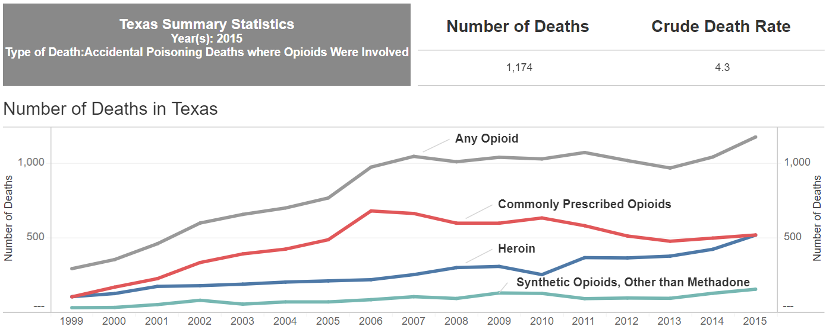
Opioid-Related Deaths in Texas
Notes:
For 2011-2015-period, there were a total of 1,223 opioid related deaths and we have been seeing a steady increase.
By year
2015- 266 deaths
2014 – 248 deaths
2013 - 237 deaths
2012 – 234 deaths
2011 – 238 deaths

Slide 4
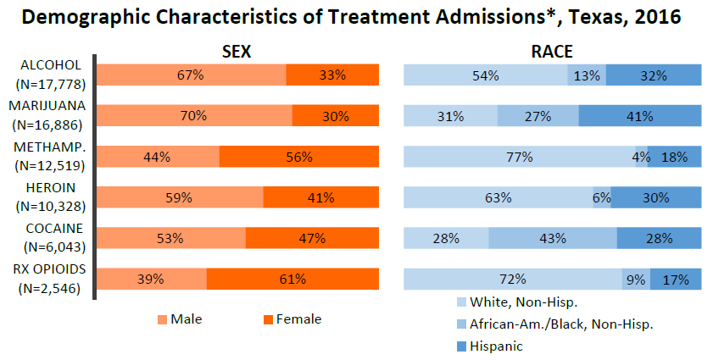
National Drug Early Warning System (NDEWS)
*Treatment Admissions: Includes all admissions reported to the Clinical Management for Behavioral Health Services (CMBHS) of the Department of State Health Services (DSHS). **Methamphetamine: Includes amphetamines and methamphetamine. Percentages may not sum to 100 due to rounding. See Sentinel Community Site (SCS) Data Tables and Overview & Limitations section for more information regarding the data. Source: Data provided by the Texas NDEWS SCE and the Texas Department of State Health Services (DSHS).
Notes:
The National Drug Early Warning System (NDEWS) is a surveillance system funded by the National Institute of Drug Abuse (NIDA) and the Austin site covers Texas.
Texas (UT Austin) is the sentinel site for the National Drug Early Warning System (NDEWS).
Table presents a breakdown by gender and race
Those seeking treatment for heroin are mostly men (59%) and white (63%)
Those seeking treatment for prescription opioids is mostly women (61%) and white (73%)
Seeking treatment for cocaine we see larger proportion of blacks (43%)

Slide 5
Opioids in Houston
There were 236 OD deaths in Harris County in first ten months of 2017
41% of the decedents were found to have a narcotic in their system
Only a handful were opiate-only overdoses.
Notes:
The Harris County Institute of Forensic Science (Medical Examiner's Office) provided us with a data base of the overdose deaths for 2017 from January through October.
There were 236 OD deaths in Harris County
41% (97) of them to be cases where the decedent was found to have a narcotic in their system.
Most of these were multiple drug overdoses, but narcotics were among the drugs used.
Only a handful were opiate-only overdoses. Nearly ALL were multi-drug ingestions.

Slide 6
1,087
HFD transports in the first seven months of 2017 were due to suspected drug overdose
10%
Suspected to have abused narcotics/opiates
Notes:
HFD transported 1,087 persons to hospitals from January to July 2017 due to a suspected drug overdose.
Only 113 of them (10%) were suspected to have abused narcotics/opiates.
This is a subjective determination on the part of the firefighter (generally based on what the patient/bystanders report), it is likely a significant underestimation.
HPD Narcotics tell us that most of the pills being sold on the street are not what they are advertised as, and most are a variety of drugs in a single pill/powder.
For those abusing opiates, Heroin continues to be the local drug most commonly abused however we are starting to see an increase in the use of Fentanyl and its related compounds (Carfentanyl, Sulfentanyl, etc.).
The problems seen in communities to our north are mostly related to Fentanyl and its related compounds. We fear we are just beginning to see the problems arising locally.

Slide 7
$780K
Estimated costs for transports involving prescription medication overdose in seven month period
Notes:
Based on the latest cost of service study, the cost to the city to effect a transport is approximately $1,876.
HFD switched over to a new patient record system May 28, 2017. From May 28 until Jan. 19, 2018 HFD transported 3,221 non-alcohol drug overdoses.
Heroin overdoses accounted for 94, and Opioids (Codiene, Vicodin, Morphine, Fentanyl, etc.) accounted for 119.
Heroin transports cost the City $176,344 and other Opioids cost the City $223,244.
While it is difficult to separate out only prescription medications from illicitly produced and made to look like legitimate pills, we estimate that at least 482 cases involved prescription medications costing the City $780,482.

Slide 8
Houston Health Department and Behavioral Health

Slide 9
Nurse Family Partnership
Nurse Home Visitation Program for first time mothers
Licensed Clinical Social Worker on staff to help clients
Life coach also available to support clients
Access to specialized mental health support
Notes:
We screen for a history of substance abuse, mental health conditions, child abuse/neglect (whether as a child victim or perpetrator, attachment issues and perinatal/postpartum anxiety /depression.
This is done as a part of the NFP’s assessment process and utilizes the PHQ9 and GAD7 for depression and anxiety disorders.
We do screenings at the following intervals:
Intake, 36 weeks gestation, 1-6 weeks postpartum (weekly)
When Baby is 4-6 Months (once), When Baby is 12 months (once)
Any additional are as needed
We have a Licensed Clinical Social Worker on staff to help clients that are in crisis or who have scores that indicate needed intervention.
We secured the services of a life coach to help clients with life planning to better manage external stressors.
We secured the services of a mental health specialist to assist clients with managing mental health crisis.
Mothers are connected back to their PCP for medication or a community provider, including Legacy and The Harris Center.
No significant concerns with opioid use.

Slide 10
PEER WELLNESS SPECIALISTS
Notes:
Peer Wellness Specialists (young people with MH conditions who provide peer supports with other young people):
No formal assessment or screening.
Services provided included education, group interventions, supportive counseling and crisis intervention.
Based on interactions and student reports, referrals to address social, medical or behavioral health needs are completed.
Students are referred to the school Social Worker, HHD’s CDBG therapist (The Harris Center employed) or Care Coordination (Kaylan)
No significant concerns with opioid use.

Slide 11
Systems of Care (SOC)
Provides wrap-around services to students and families in targeted schools
HHD Senior Counselors and Contracted Case Managers
Therapist from The Harris Centers assigned to project
Notes:
MBK System of Care (HHD’s Senior Counselors and Community Youth Services Case Managers through contract):
Intakes are completed to assess academic, social, medical and behavioral health needs.
Services provided include: Care coordination, group interventions, education, supportive counseling, crisis intervention and teacher consultation.
Referrals for therapy are provided to The Harris Center (therapist assigned to MBK).
No significant concerns with opioid use.

Slide 12
Community ReEntry Network Program
25.6%
Of enrolled participants present with at least one serious behavioral health condition
Notes:
Provides behavioral healthcare case management, referral and linkage to community providers, life skills including a comprehensive Anger Management curriculum and interventional, individual and family counseling services.
The most prevalent need of enrolled participants is linkages to brief, interventional counseling and chemical dependency support (substance use education and support groups)
During 2015, 25.6% of enrolled participants presented with at least one serious diagnosed behavioral health condition.
Studies estimate that 15% to 24% of incarcerated persons have a serious mental illness.
In 2015, about 30% of people in local Texas jails had at least one serious mental illness…” This shows that CRNP’s population also directly mirrors the population in the local jails and the state prisons.
CRNP has subcontracted with the Center for Recovery and Wellness Resources to provide services that allow people with mental health and criminal justice experience to mentor others in the justice system who are beginning the recovery and reentry process. (Peer Support)
Peers are able to share strategies, coping skills, and experiences with the state mental health system to help participants successfully navigate the difficult transition back into the community.

Slide 13
Hurricane Harvey
Notes:
In response to Hurricane Harvey, we experienced what we believe to be a microcosm of the mental and behavioral health needs in our community in the shelter at GRB.
The stresses of home loss were immediate and were expected to continue given the lack of flood insurance and hurricane deductibles that impact homeowners in the aftermath of a named storm.
For Harvey we had BCM and teams we requested through the State STAR process to address these needs.
We have since suggested that behavioral health be integrated into DMATs and during the recovery phases.
We have also suggested that state deployable behavioral health teams have prescriptive authority.

