Slide 1
Angela Singleton
Assistant Vice President
Angela.Singleton@hilltopsecurities.com
450 S. Orange Avenue, Suite 460
Orlando, Florida 32801
407.426.9611 Tel
Strategies Issuers are Using to Fund Large Capital Improvement Projects
April 4, 2019
National Forum for Black Public Administrators

Slide 2
Development and Execution of a Financing Plan
Determine the Issuer’s financial needs and goals
Perform a detailed review of:
Outstanding Debt
Covenants
Additional bonds test
Anti-dilution test
Debt service coverage
Rate Covenants
Policies / Charter Provisions
Identify the best revenue source to pledge in order to:
Obtain best credit ratings
Obtain lowest possible borrowing costs
Ensure flexibility for future operating and capital funding

Slide 3
Evaluation of Alternatives
Our Professionals will provide Expertise and Guidance on the Evaluation of Financing Alternatives and will Recommend the Most Appropriate Approach for a Particular Project
Financing Type | General Overview
Pay-As-You-Go | Issuer pays for projects with funds on-hand Opportunity cost of using cash vs. borrowing must be analyzed
Bond Issue | Allows the Issuer to borrow funds through a payment structure of 20-30-years (or longer) Longer duration and efficiency in the capital markets can help to offset potentially high issuance costs Significant documentation and ongoing continuing disclosure required
Bank Loan | Often utilized for shorter duration financings and where the issue size may be relatively small Do not require as much documentation as a bond offering and generally has limited ongoing reporting requirements Can contain gross-up provisions and/or capital adequacy provisions
Pooled Loan Program | Various pooled loan programs exist to provide economies of scale for smaller or lower rated borrowings Lower rated credits have historically been subsidized by the higher credits in the pools
Commercial Paper | Can provide low interest, short-term financing for projects or construction financing May need economies of scale in order to overcome credit and professional costs
Letter / Line of Credit | Letter of credit is used to guaranty a payment; often used as an enhancement to variable rate debt Line of credit is a loan from a financial institution that allows discretionary use of funds up to a specified limit
Governmental Loan | SRF loans have historically provided a relatively low cost of capital to utilities in Florida SIB loans can provide low financing costs for transportation related projects TIFIA loans are a useful financing component, but can take significant time to obtain and may contain unwanted stipulations
Internal Loan Funding | A municipality could utilize internal banking functions to provide loans to other funds Can create some risk, use additional staff time, and may not efficiently price risk/reward
COP / Lease Backed | COPs can provide for an annual appropriation structure that does not receive a long-term obligation classification Financing equipment/vehicles that have relatively short useful lives can potentially benefit from a lease structure
Public-Private Partnership | P3 financings can provide equity capital structure for various projects, but require a ROI Lease structures and/or divestitures of assets can provide payment streams to use on other projects Private parties may be willing to take additional risk in certain instances for a start-up project Private entities will more than likely not be able to obtain a lower cost capital structure than a highly rated municipality

Slide 4
Competitive versus Negotiated Sale

Slide 5
Credit Rating Process
Assist the Issuer with creating the rating presentation and submitting informational package.
Review all pertinent information concerning the credit and prepare the Issuer for anticipated questions.
Prepare rating agency “scorecard” models to identify potential credit strengths and weakness.
Moody’s Local Government GO Scorecard
Rating Factor | Weighting
Economy 20%
Income | 10%
Industrial Diversity | 5%
Employment Volatility | 5%
Governance 30%
Financial Best Practices | 15%
Financial Flexibility/Constitutional Constraints | 15%
Finances 30%
Revenues | 10%
Balances & Reserves | 10%
Liquidity | 10%
Debt 20%
Bonded Debt | 10%
Adjusted Net Pension Liability | 10%

Slide 6
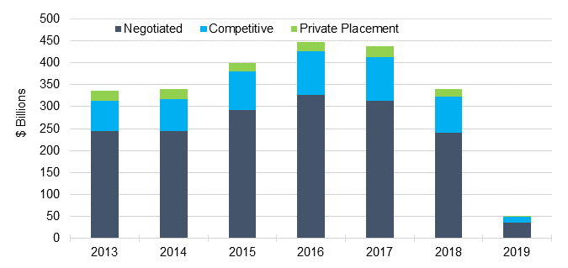
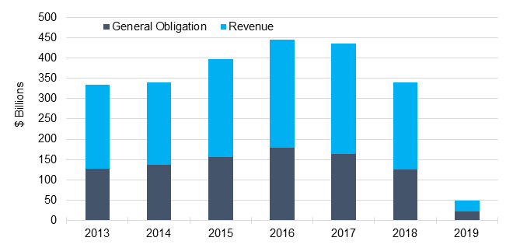
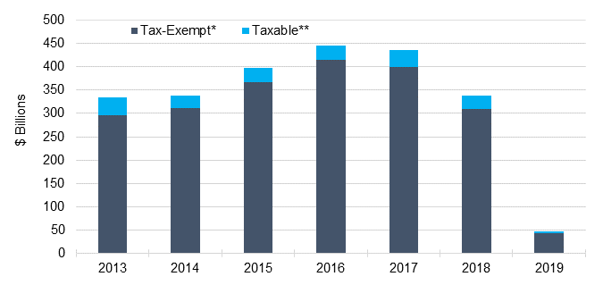
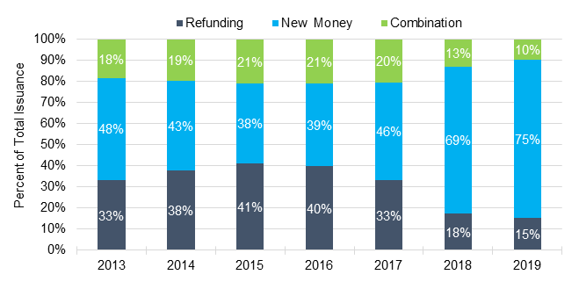
Municipal Bond Issuance Statistics | Analysis by Issuance Type
Negotiated vs Competitive vs Private Placement
Revenue vs General Obligation
Taxable vs Tax-Exempt
Refunding vs New Money
* Tax-Exempt Includes AMT Bonds **Taxable Includes Stimulus Bonds
Source: The Bond Buyer “A Decade of Bond Finance” and Thomson Reuters (based on data available through February 28, 2019) Excludes Notes

