Slide 1
Deaf/Hard-of-Hearing: A guide to providing Comprehensive HIV/AIDS Awareness
Rachelle Louidor

Slide 2
Fun Fact

Slide 3
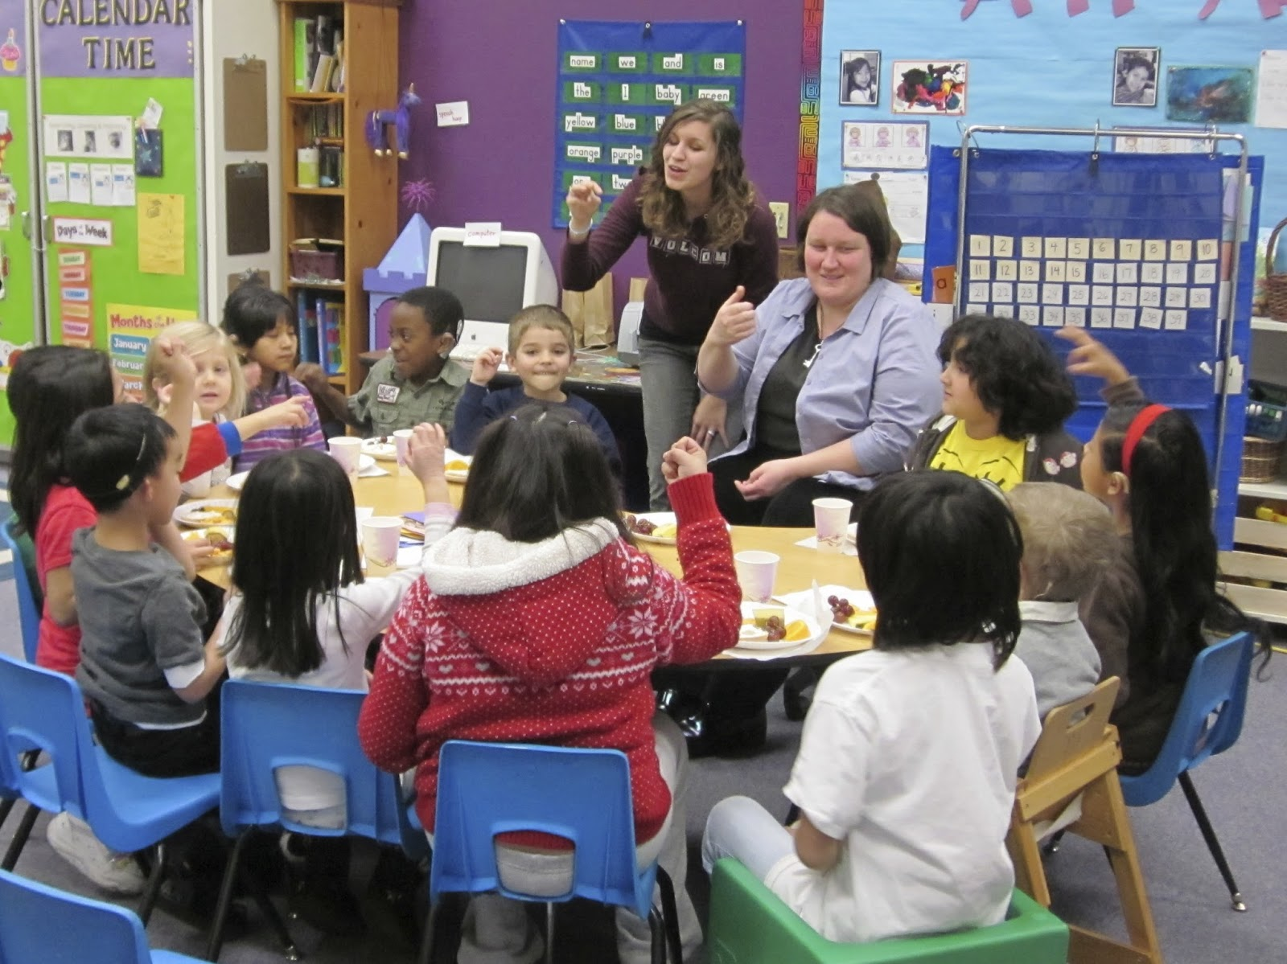
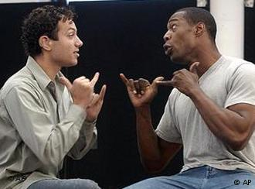
ASL ≠ English

Slide 4
Key Terms
D/HH – Deaf/Hard-of-Hearing Individual
Someone with a moderate to profound hearing loss in 1 or both ears
Types of Education available for D/HH
Mainstream – Neighborhood/County Public school, integrated with hearing students & has an interpreter
Residential School – School for the Deaf, all Deaf/Sign all the time
Interpreter
Someone who bridges the gap of communication between D/HH and hearing environment
CDC HIV/AIDS Subgroups
Certain groups highlighted on the CDC website because they are at higher risk for HIV and merit special consideration because of particular risk factors.

Slide 5
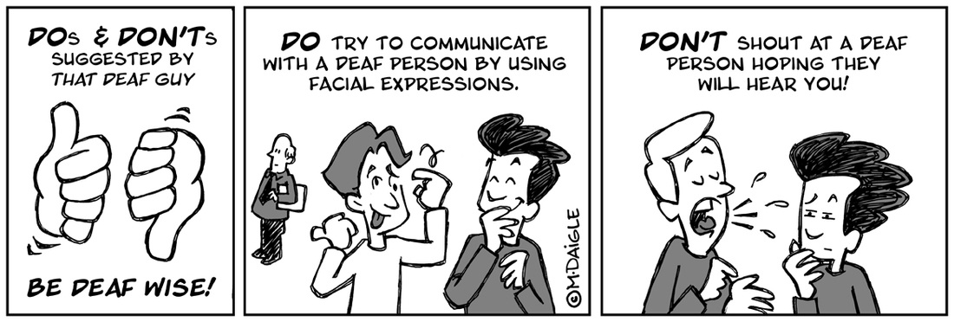
Key Terms(cont.)
ASL – American Sign Language
A language completely DIFFERENT from English. ASL ≠ English on the hands
Big D vs Little d & D-O-D
D – cultural group, d – medical disability, D-O-D: Deaf of Deaf – 1 or both parents are D/HH
HIPAA - Health Insurance Portability and Accountability Act of 1996
Information Privacy/Confidentiality between doctor & patient

Slide 6
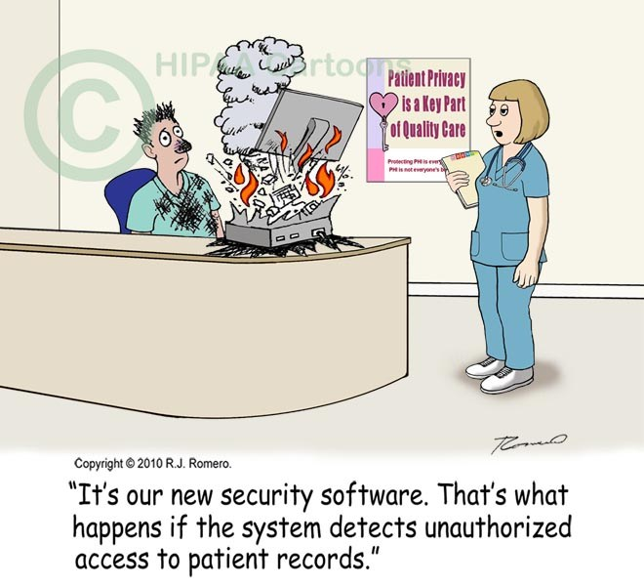
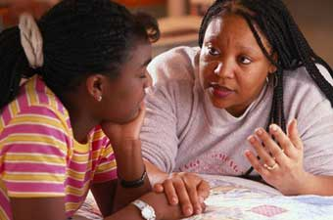
Barriers to Being Healthy
Confidentiality
Education
Information Dissemination

Slide 7
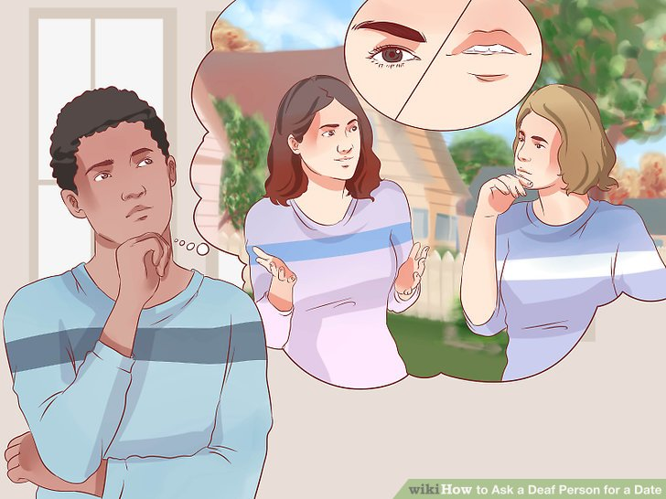
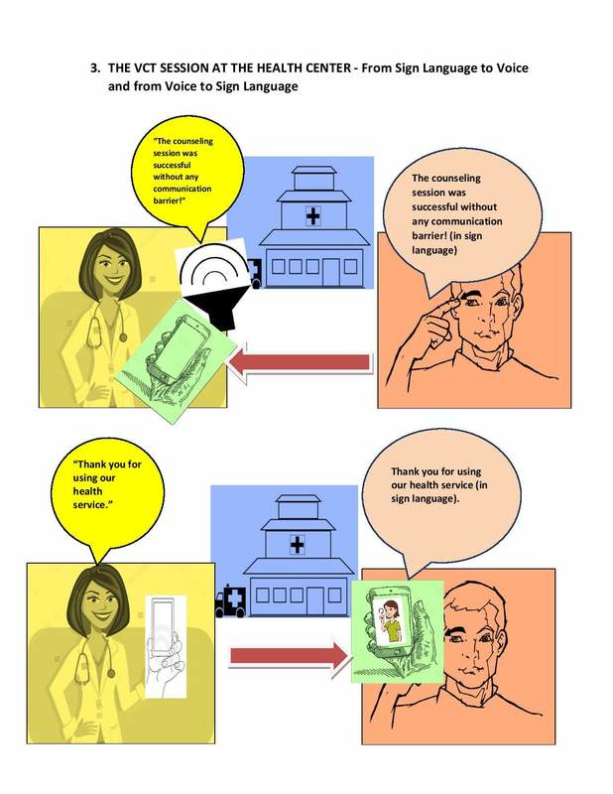
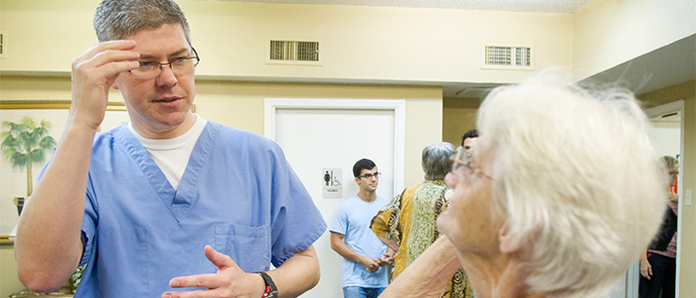
Confidentiality
Communication/Language Barriers
Interpreter present
Ideal Situation

Slide 8
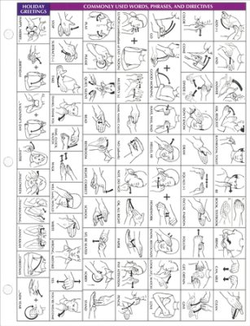
Education
Limited information accessible to D/HH
HIV/AIDS resources 8th grade level w/ jargon
Ideal Situation

Slide 9
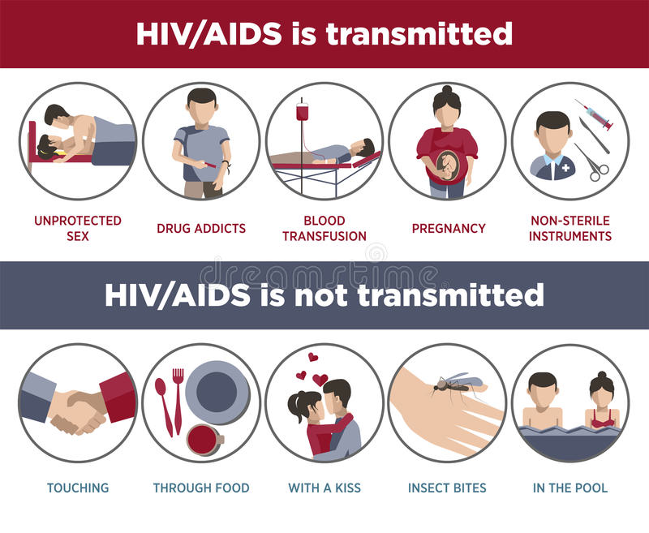
Information Dissemination
Cultural needs not taken into consideration
Materials geared towards hearing population
Ideal Situation

Slide 10
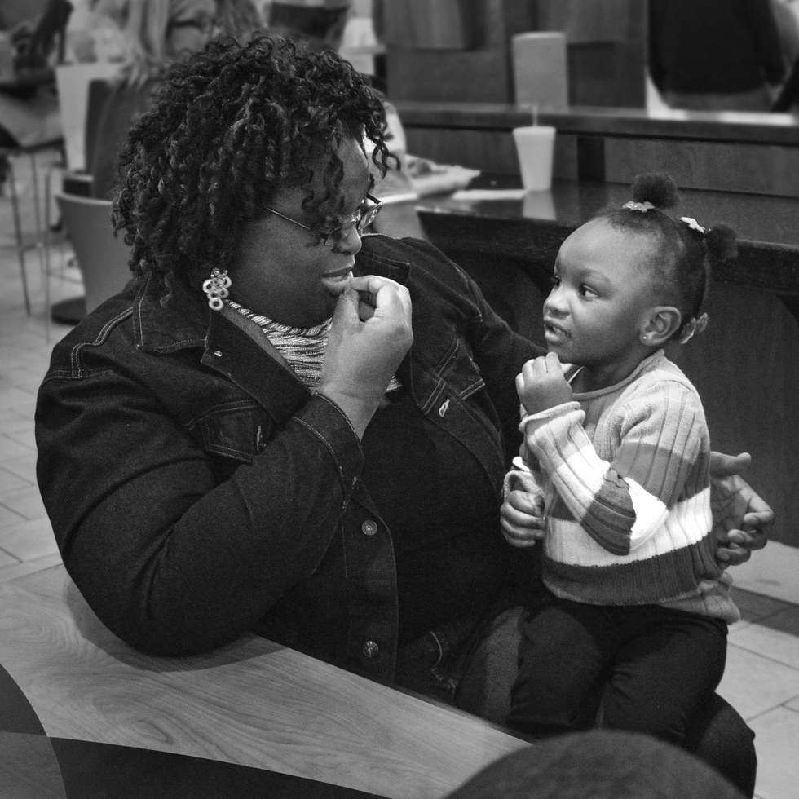
D/HH African-Americans & HIV
“vulnerable minority”
lack of information and education leads to risky behaviors
imamate the negative social behaviors of their hearing peers in order to fit in
lower education and lower annual household income = lower testing rate
Ideal Situation

Slide 11
Proposals/Recommendations
Doctors’ office should be equipped with different videos in sign language to help answer common questions about testing, the disease and resources
host community classes to educate D/HH individuals.
Create pamphlets and other written materials at a 4th – 5th grade level and include a lot of visuals
Materials should be created with D/HH individuals
Videos should be created in Sign Language for schools and communities.
Community fairs at local D/HH events where HIV/AIDS is shared with the D/HH community

